Slide 1

Chapter 15
Linked Data Structures
Slides prepared by Rose Williams, Binghamton University
Kenrick Mock, University of Alaska Anchorage

Slide 2
Introduction to Linked Data Structures
A linked data structure consists of capsules of data known as nodes that are connected via links
Links can be viewed as arrows and thought of as one way passages from one node to another
In Java, nodes are realized as objects of a node class
The data in a node is stored via instance variables
The links are realized as references
A reference is a memory address, and is stored in a variable of a class type
Therefore, a link is an instance variable of the node class type itself

Slide 3
Java Linked Lists
The simplest kind of linked data structure is a linked list
A linked list consists of a single chain of nodes, each connected to the next by a link
The first node is called the head node
The last node serves as a kind of end marker

Slide 4
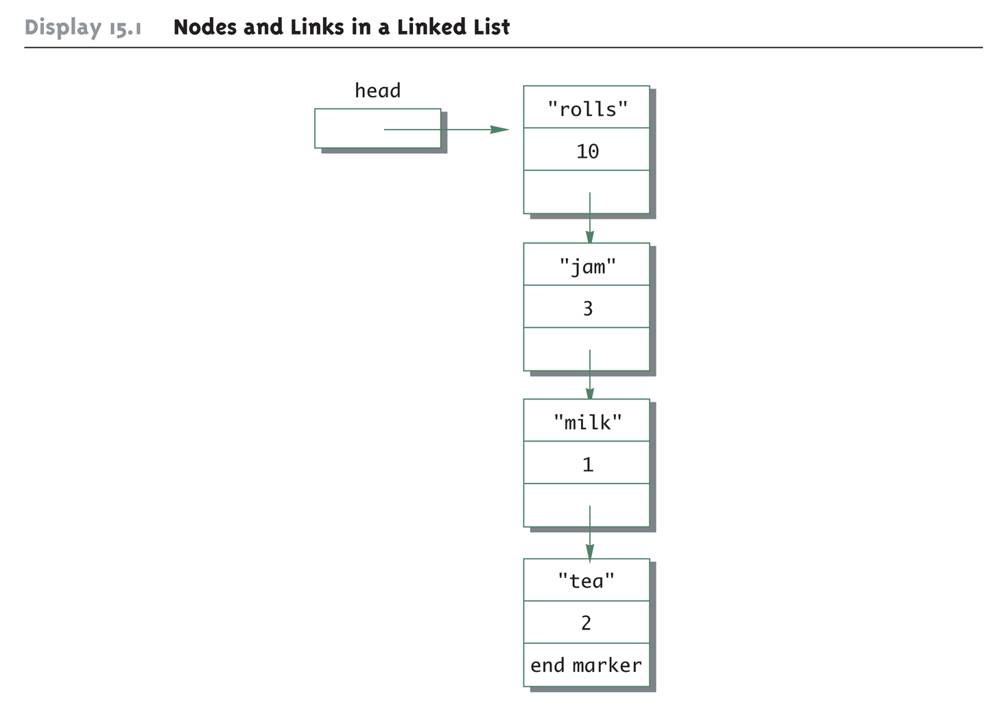
Nodes and Links in a Linked List

Slide 5
A Simple Linked List Class
In a linked list, each node is an object of a node class
Note that each node is typically illustrated as a box containing one or more pieces of data
Each node contains data and a link to another node
A piece of data is stored as an instance variable of the node
Data is represented as information contained within the node "box"
Links are implemented as references to a node stored in an instance variable of the node type
Links are typically illustrated as arrows that point to the node to which they "link"

Slide 6
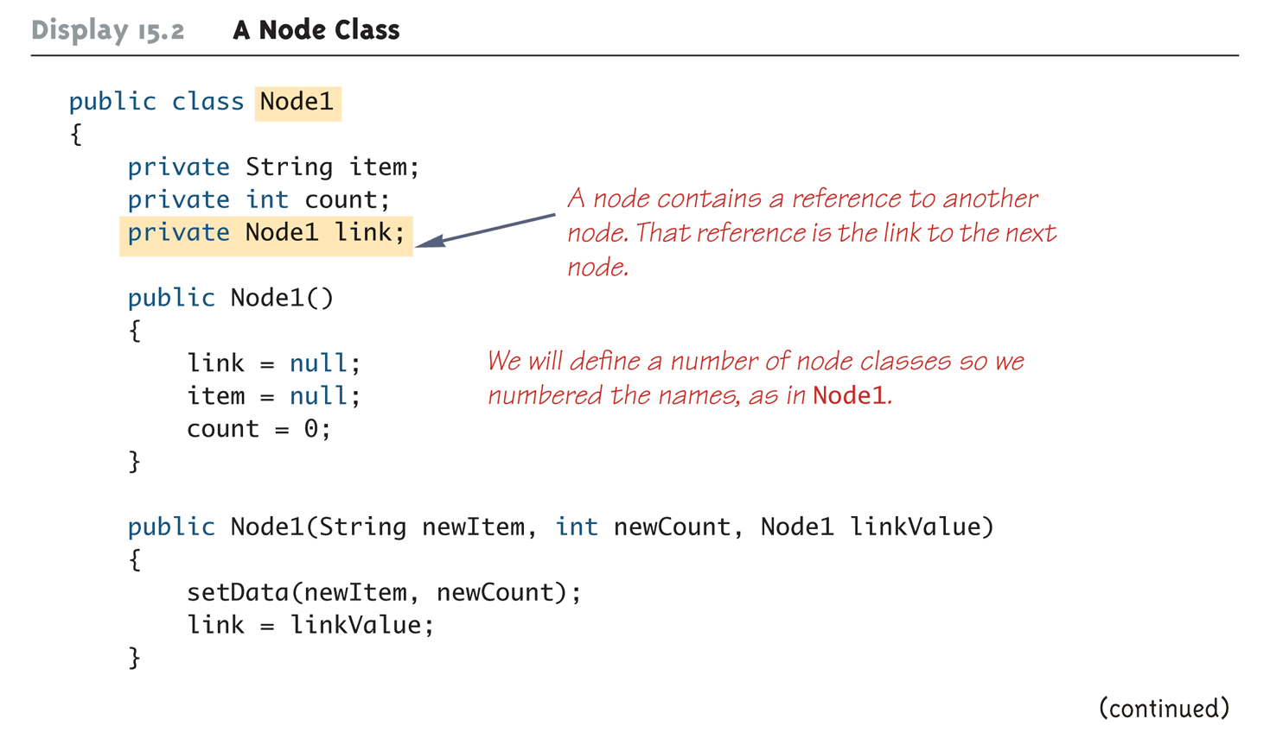
A Node Class (Part 1 of 3)

Slide 7
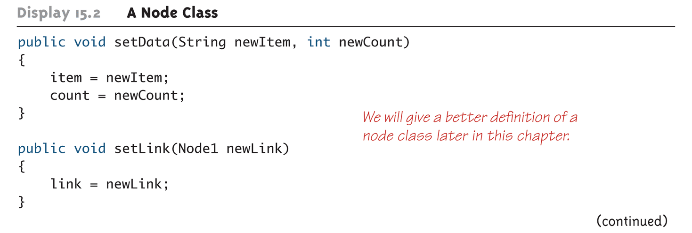
A Node Class (Part 2 of 3)

Slide 8
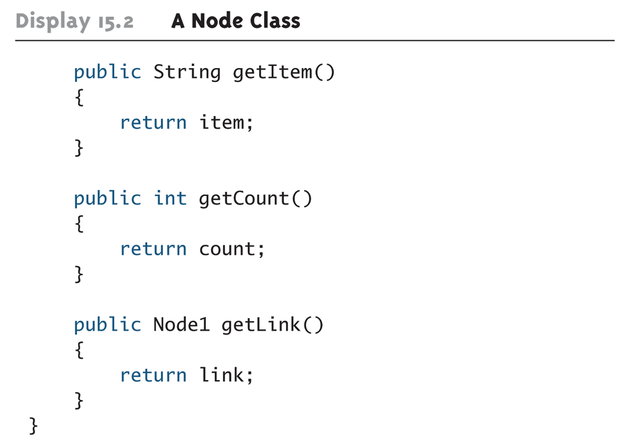
A Node Class (Part 3 of 3)

Slide 9
A Simple Linked List Class
The first node, or start node in a linked list is called the head node
The entire linked list can be traversed by starting at the head node and visiting each node exactly once
There is typically a variable of the node type (e.g., head) that contains a reference to the first node in the linked list
However, it is not the head node, nor is it even a node
It simply contains a reference to the head node

Slide 10
A Simple Linked List Class
A linked list object contains the variable head as an instance variable of the class
A linked list object does not contain all the nodes in the linked list directly
Rather, it uses the instance variable head to locate the head node of the list
The head node and every node of the list contain a link instance variable that provides a reference to the next node in the list
Therefore, once the head node can be reached, then every other node in the list can be reached

Slide 11
An Empty List Is Indicated by null
The head instance variable contains a reference to the first node in the linked list
If the list is empty, this instance variable is set to null
Note: This is tested using ==, not the equals method
The linked list constructor sets the head instance variable to null
This indicates that the newly created linked list is empty

Slide 12
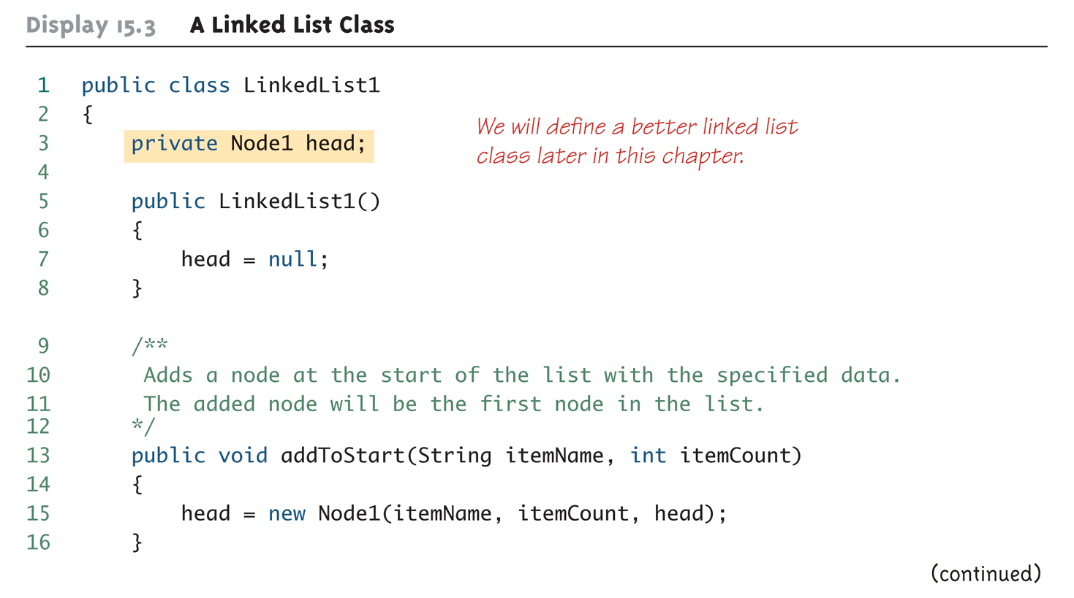
A Linked List Class (Part 1 of 6)

Slide 13
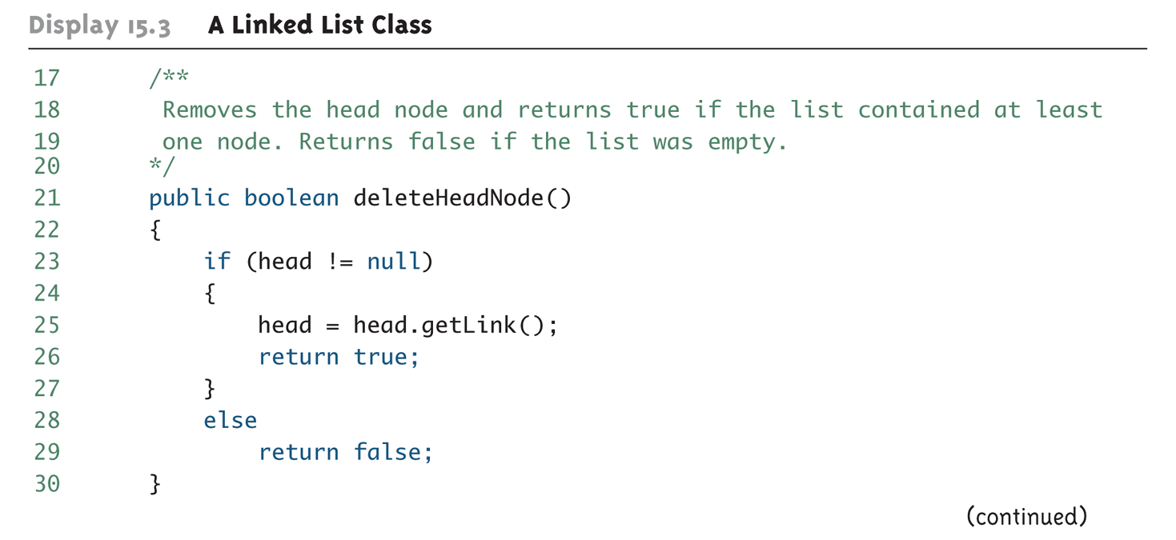
A Linked List Class (Part 2 of 6)

Slide 14
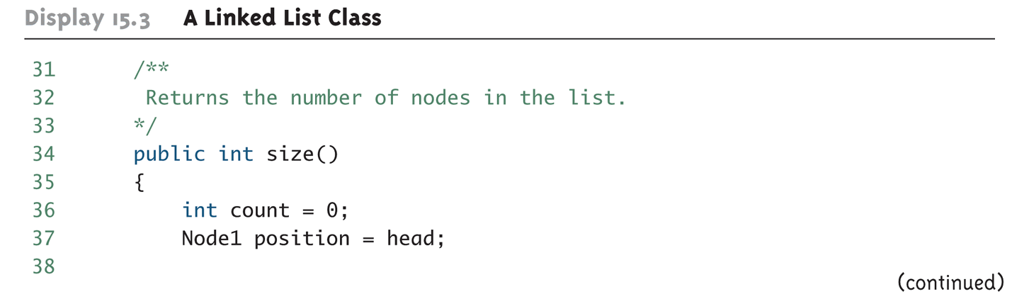
A Linked List Class (Part 3 of 6)

Slide 15
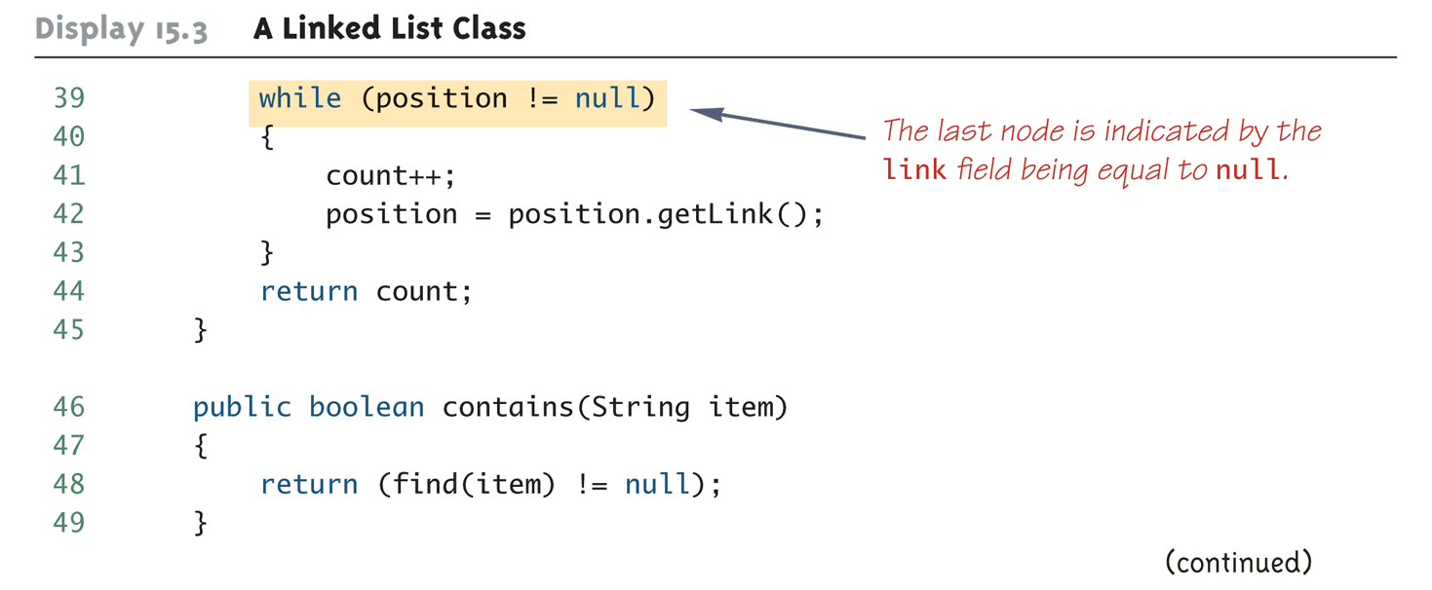
A Linked List Class (Part 4 of 6)

Slide 16
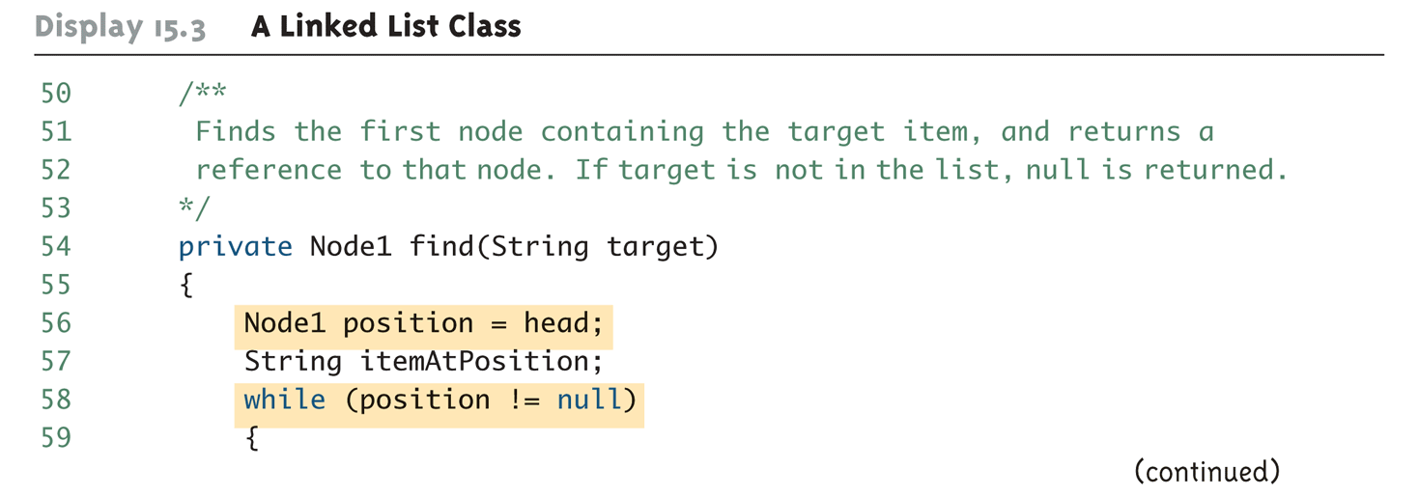
A Linked List Class (Part 5 of 6)

Slide 17
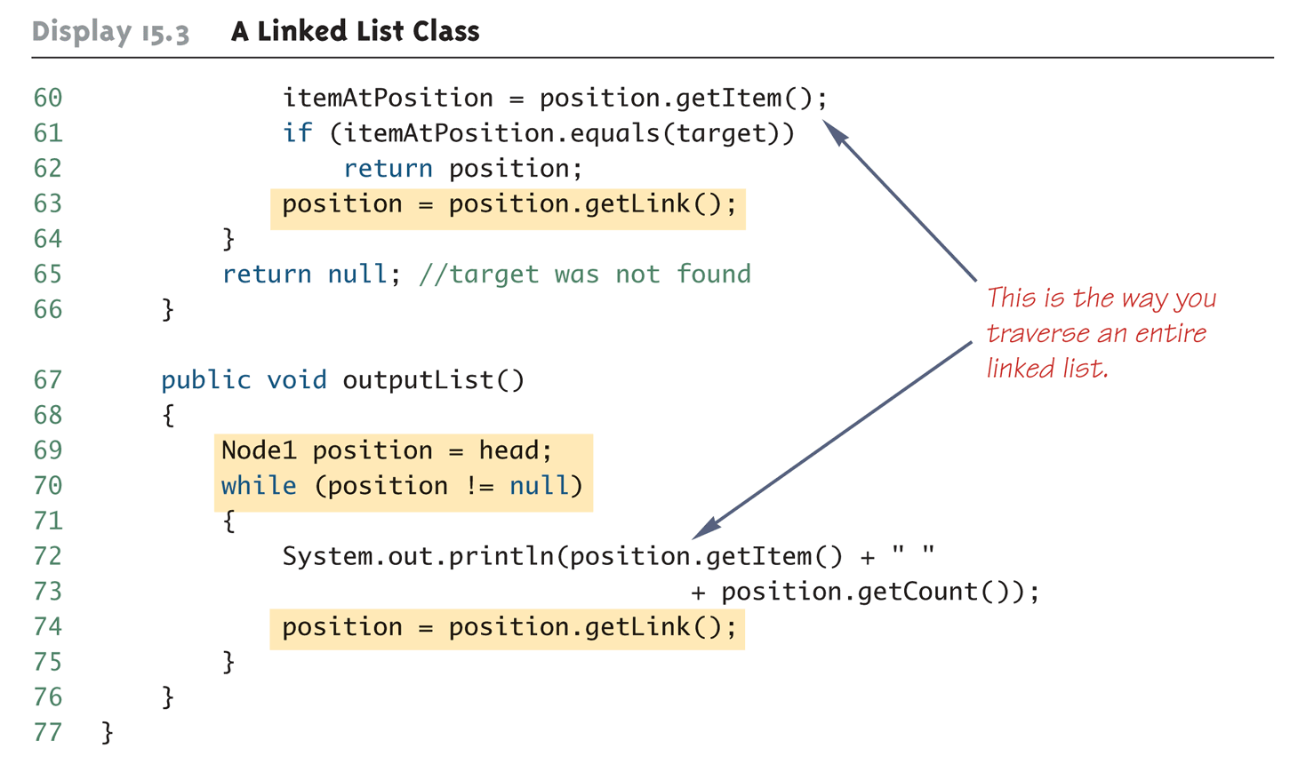
A Linked List Class (Part 6 of 6)

Slide 18
Indicating the End of a Linked List
The last node in a linked list should have its link instance variable set to null
That way the code can test whether or not a node is the last node
Note: This is tested using ==, not the equals method

Slide 19
Traversing a Linked List
If a linked list already contains nodes, it can be traversed as follows:
Set a local variable equal to the value stored by the head node (its reference)
This will provides the location of the first node
After accessing the first node, the accessor method for the link instance variable will provide the location of the next node
Repeat this until the location of the next node is equal to null

Slide 20
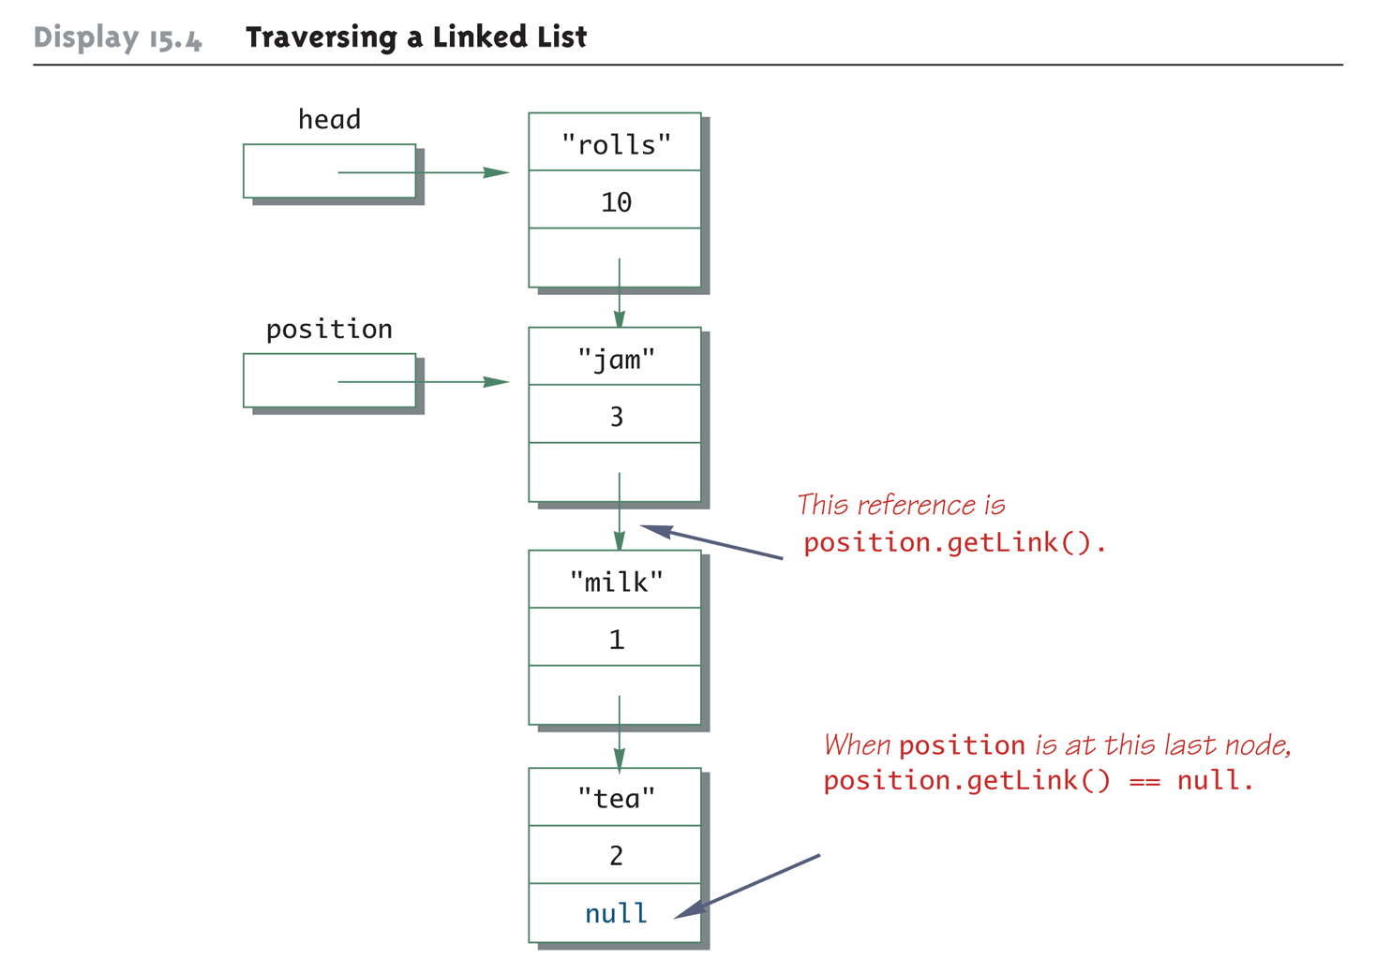
Traversing a Linked List

Slide 21
Adding a Node to a Linked List
The method add adds a node to the start of the linked list
This makes the new node become the first node on the list
The variable head gives the location of the current first node of the list
Therefore, when the new node is created, its link field is set equal to head
Then head is set equal to the new node

Slide 22
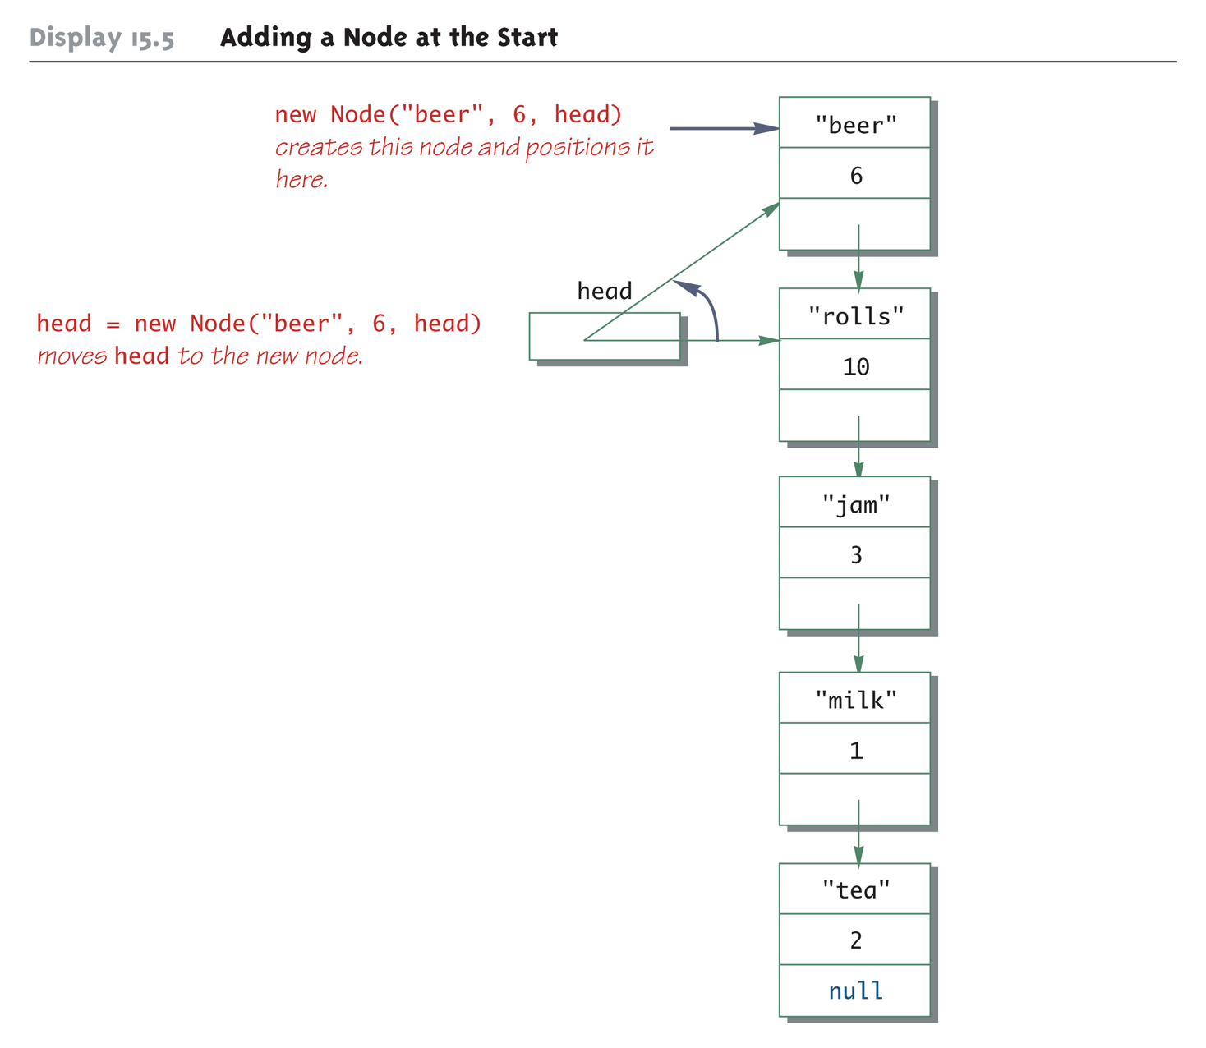
Adding a Node at the Start

Slide 23
Deleting the Head Node from a Linked List
The method deleteHeadNode removes the first node from the linked list
It leaves the head variable pointing to (i.e., containing a reference to) the old second node in the linked list
The deleted node will automatically be collected and its memory recycled, along with any other nodes that are no longer accessible
In Java, this process is called automatic garbage collection

Slide 24
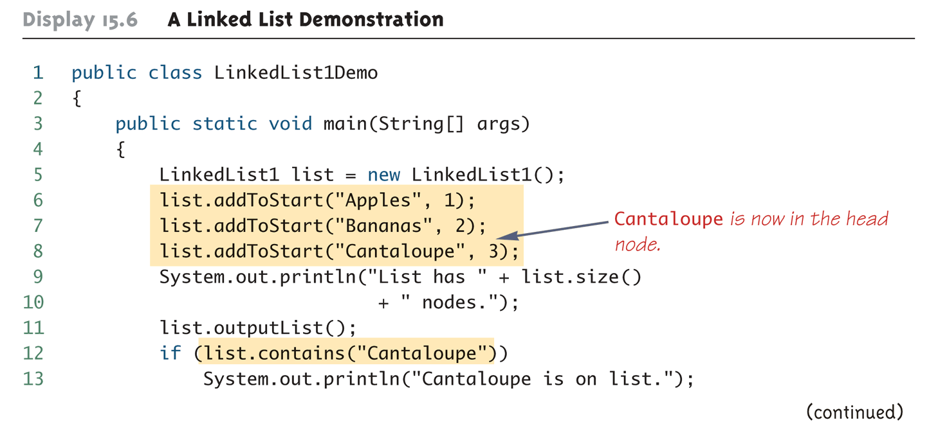
A Linked List Demonstration (Part 1 of 3)

Slide 25
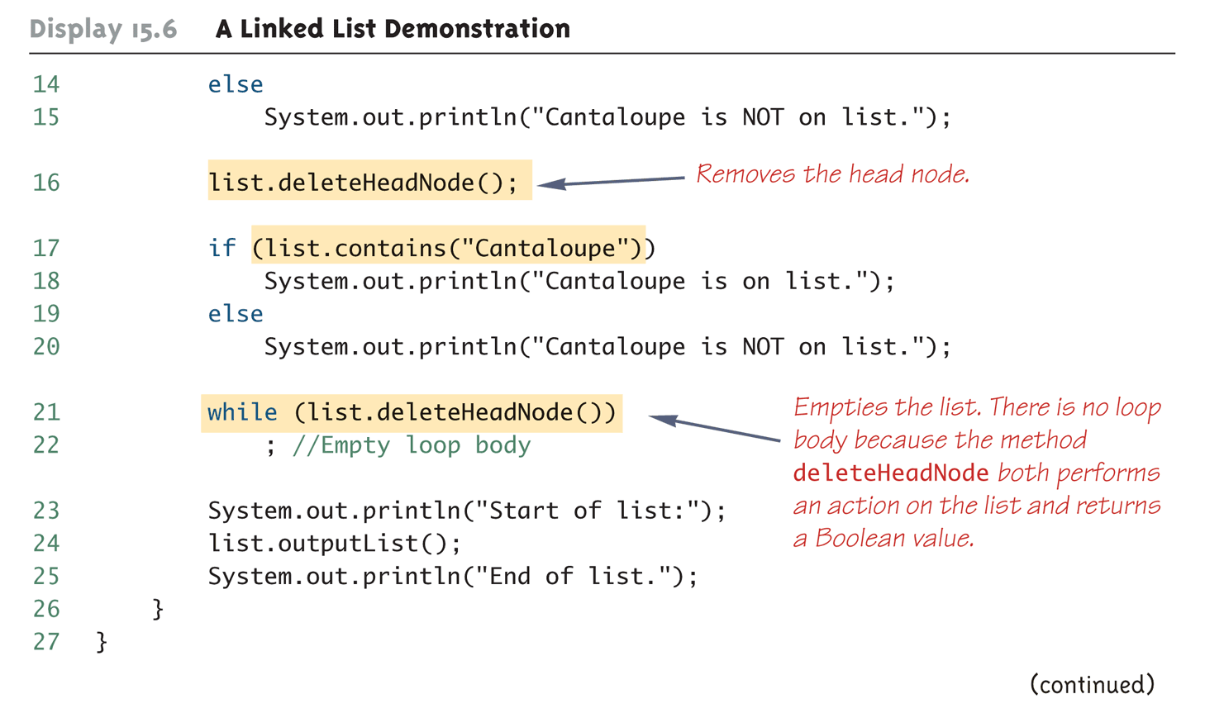
A Linked List Demonstration (Part 2 of 3)

Slide 26

A Linked List Demonstration (Part 3 of 3)

Slide 27
Node Inner Classes
Note that the linked list class discussed so far is dependent on an external node class
A linked list or similar data structure can be made self-contained by making the node class an inner class
A node inner class so defined should be made private, unless used elsewhere
This can simplify the definition of the node class by eliminating the need for accessor and mutator methods
Since the instance variables are private, they can be accessed directly from methods of the outer class without causing a privacy leak

Slide 28
Pitfall: Privacy Leaks
The original node and linked list classes examined so far have a dangerous flaw
The node class accessor method returns a reference to a node
Recall that if a method returns a reference to an instance variable of a mutable class type, then the private restriction on the instance variables can be easily defeated
The easiest way to fix this problem would be to make the node class a private inner class in the linked list class

Slide 29
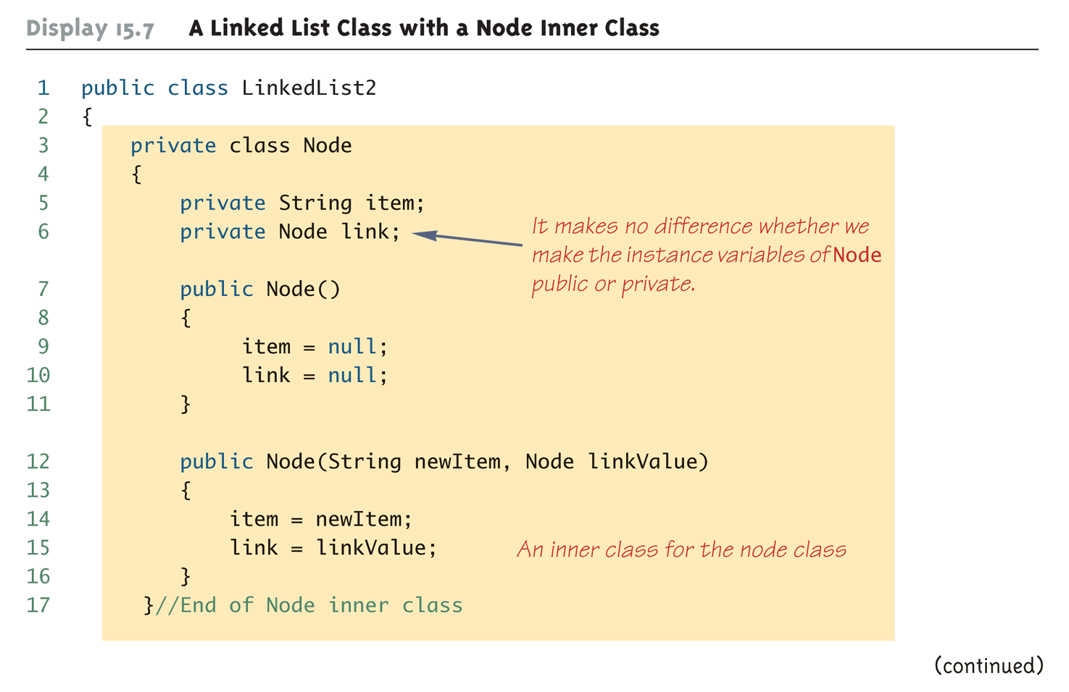
A Linked List Class with a Node Inner Class (Part 1 of 6)

Slide 30
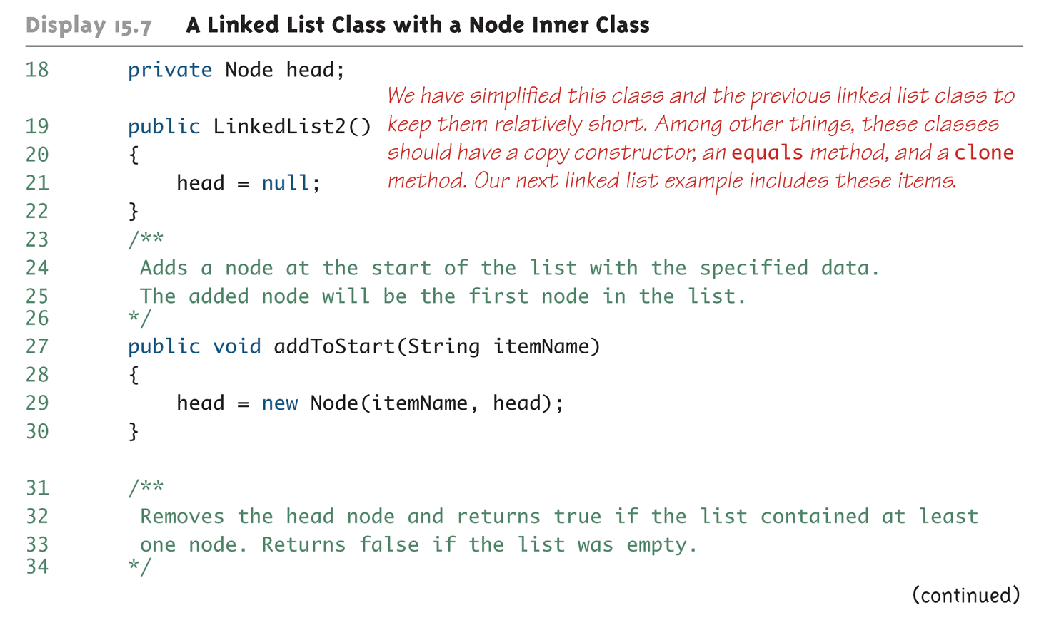
A Linked List Class with a Node Inner Class (Part 2 of 6)

Slide 31
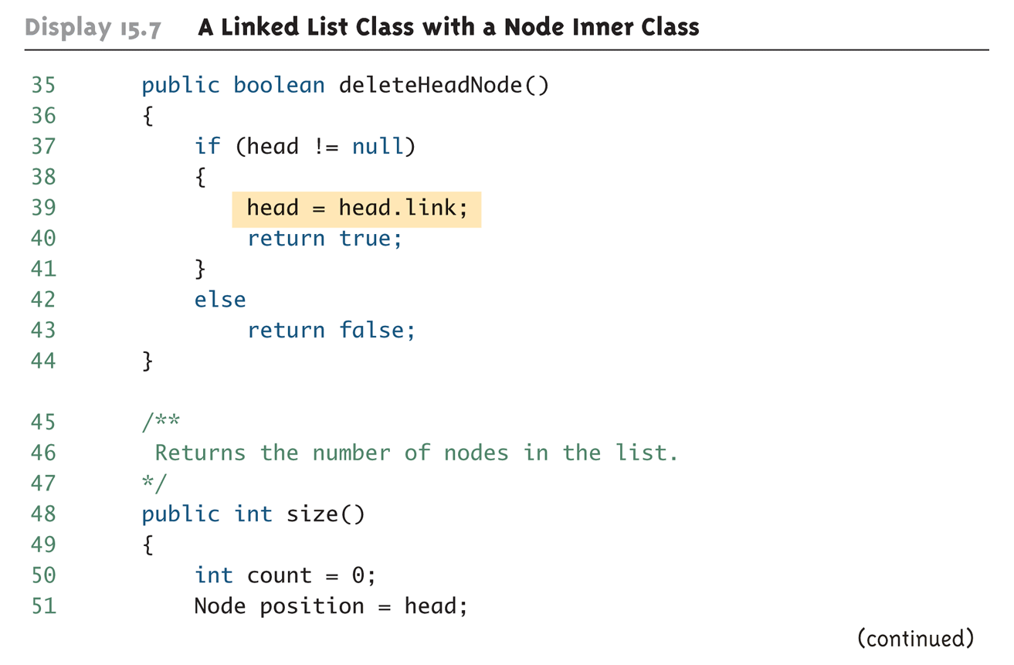
A Linked List Class with a Node Inner Class (Part 3 of 6)

Slide 32
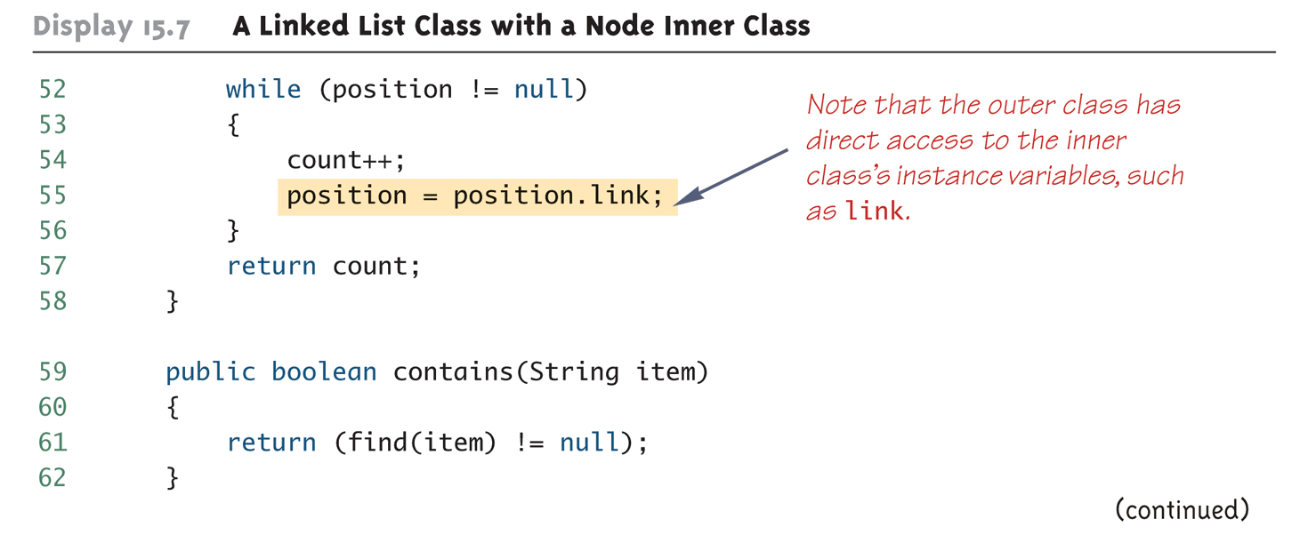
A Linked List Class with a Node Inner Class (Part 4 of 6)

Slide 33
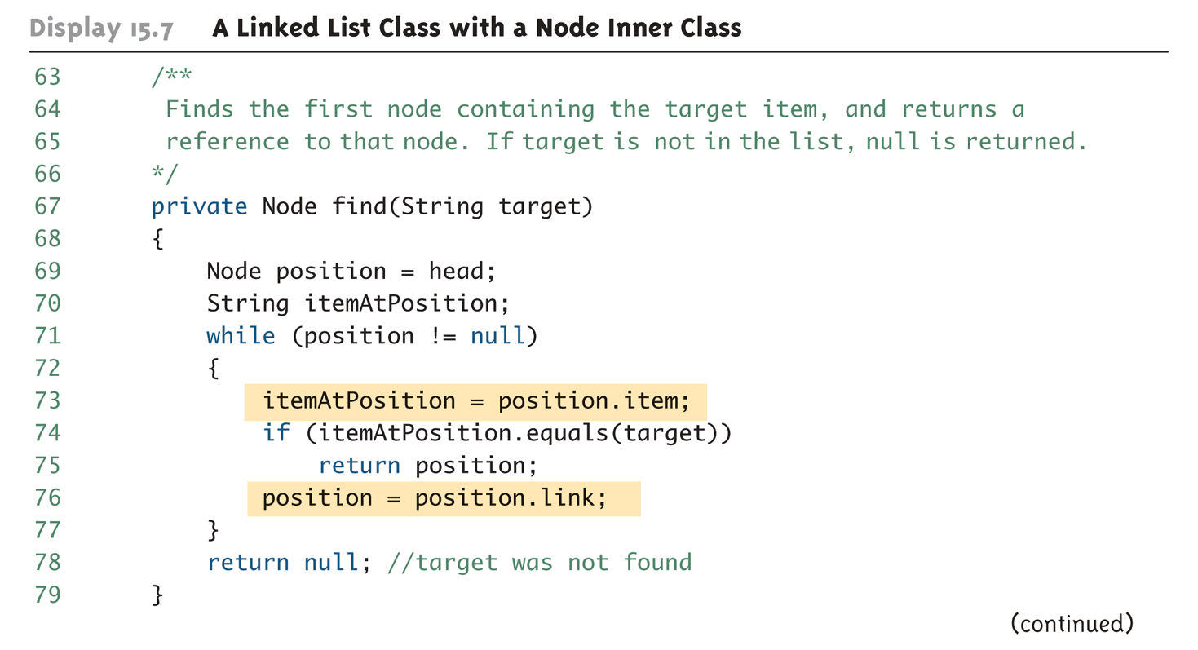
A Linked List Class with a Node Inner Class (Part 5 of 6)

Slide 34
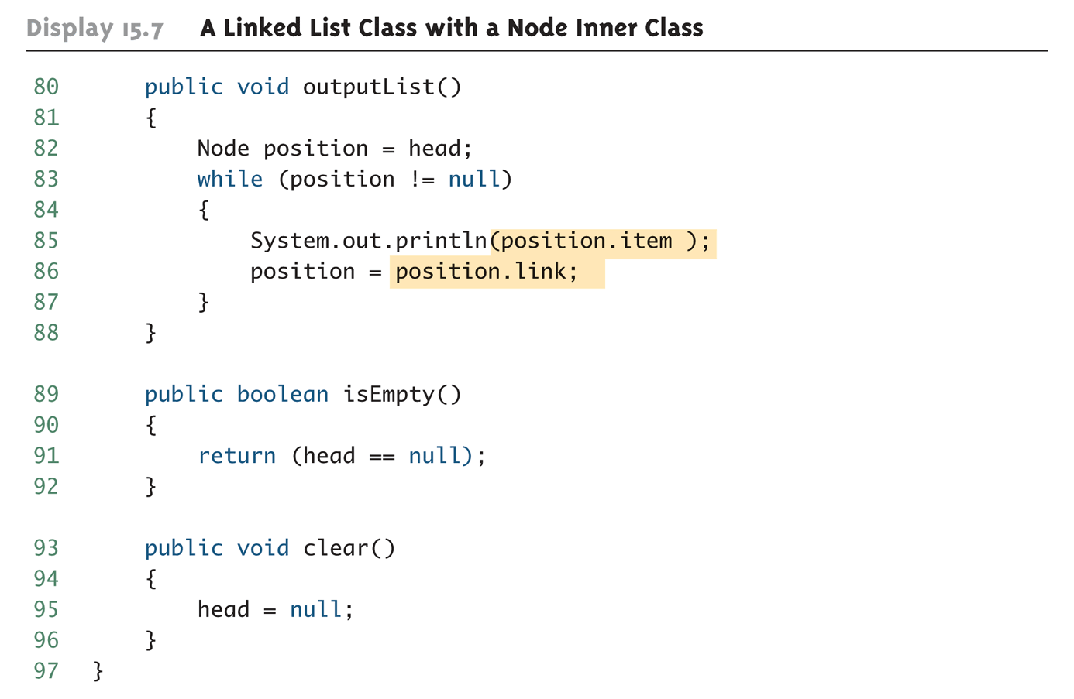
A Linked List Class with a Node Inner Class (Part 6 of 6)

Slide 35
A Generic Linked List
A linked list can be created whose Node class has a type parameter T for the type of data stored in the node
Therefore, it can hold objects of any class type, including types that contain multiple instance variable
The type of the actual object is plugged in for the type parameter T
For the most part, this class can have the same methods, coded in basically the same way, as the previous linked list example
The only difference is that a type parameter is used instead of an actual type for the data in the node
Other useful methods can be added as well

Slide 36
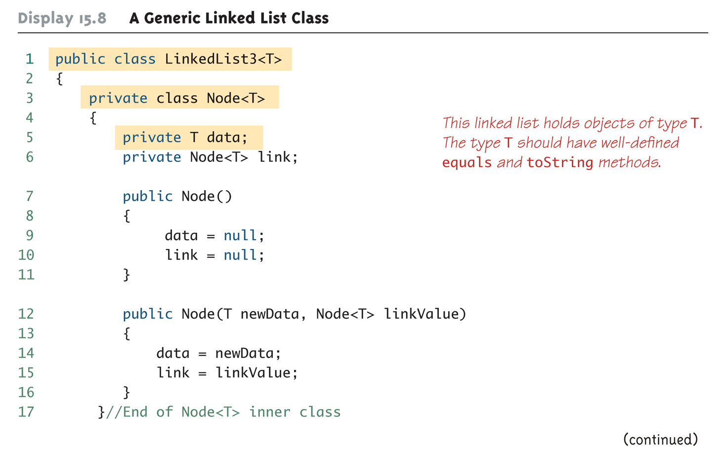
A Generic Linked List Class (Part 1 of 9)

Slide 37
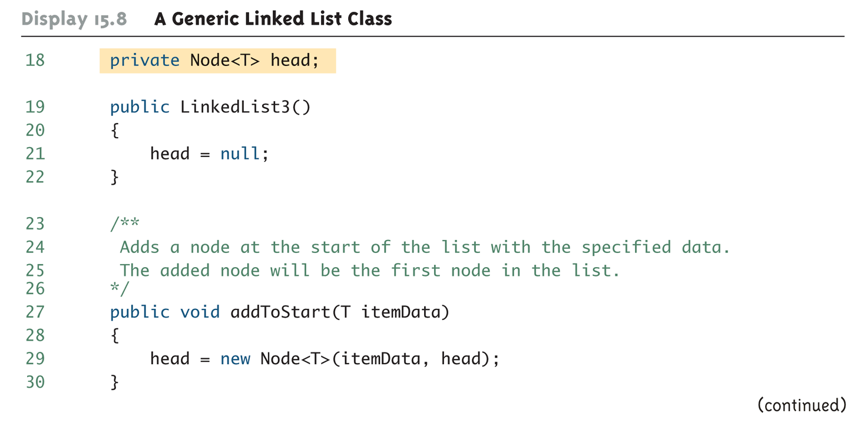
A Generic Linked List Class (Part 2 of 9)

Slide 38
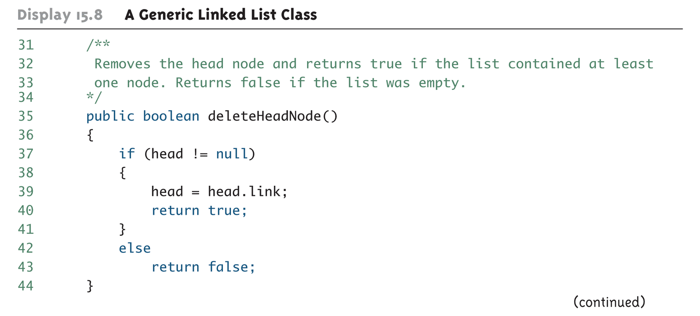
A Generic Linked List Class (Part 3 of 9)

Slide 39
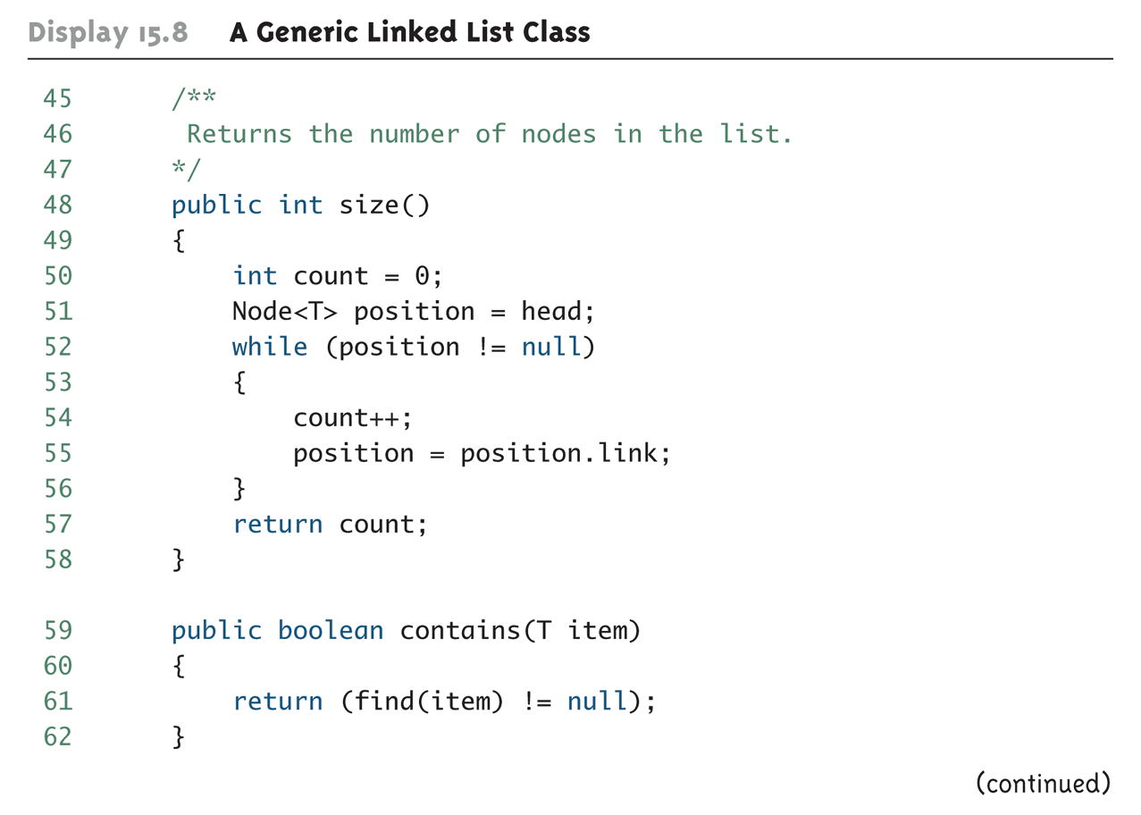
A Generic Linked List Class (Part 4 of 9)

Slide 40
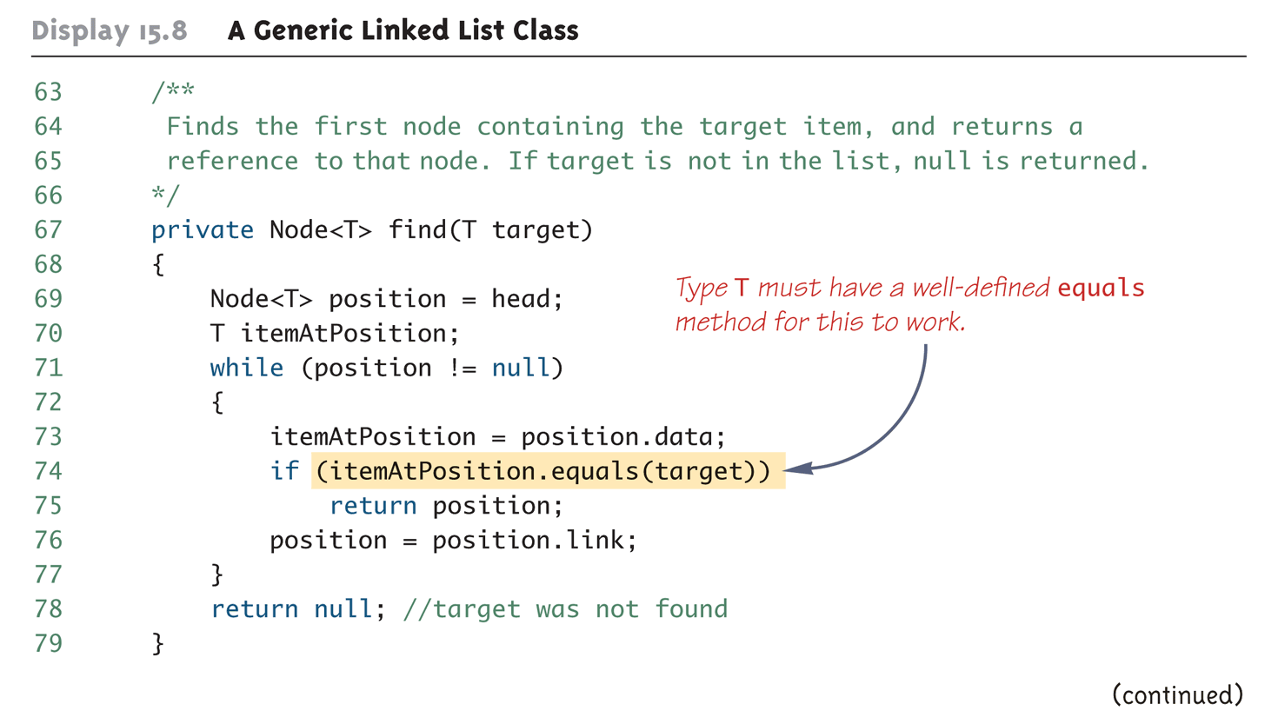
A Generic Linked List Class (Part 5 of 9)

Slide 41
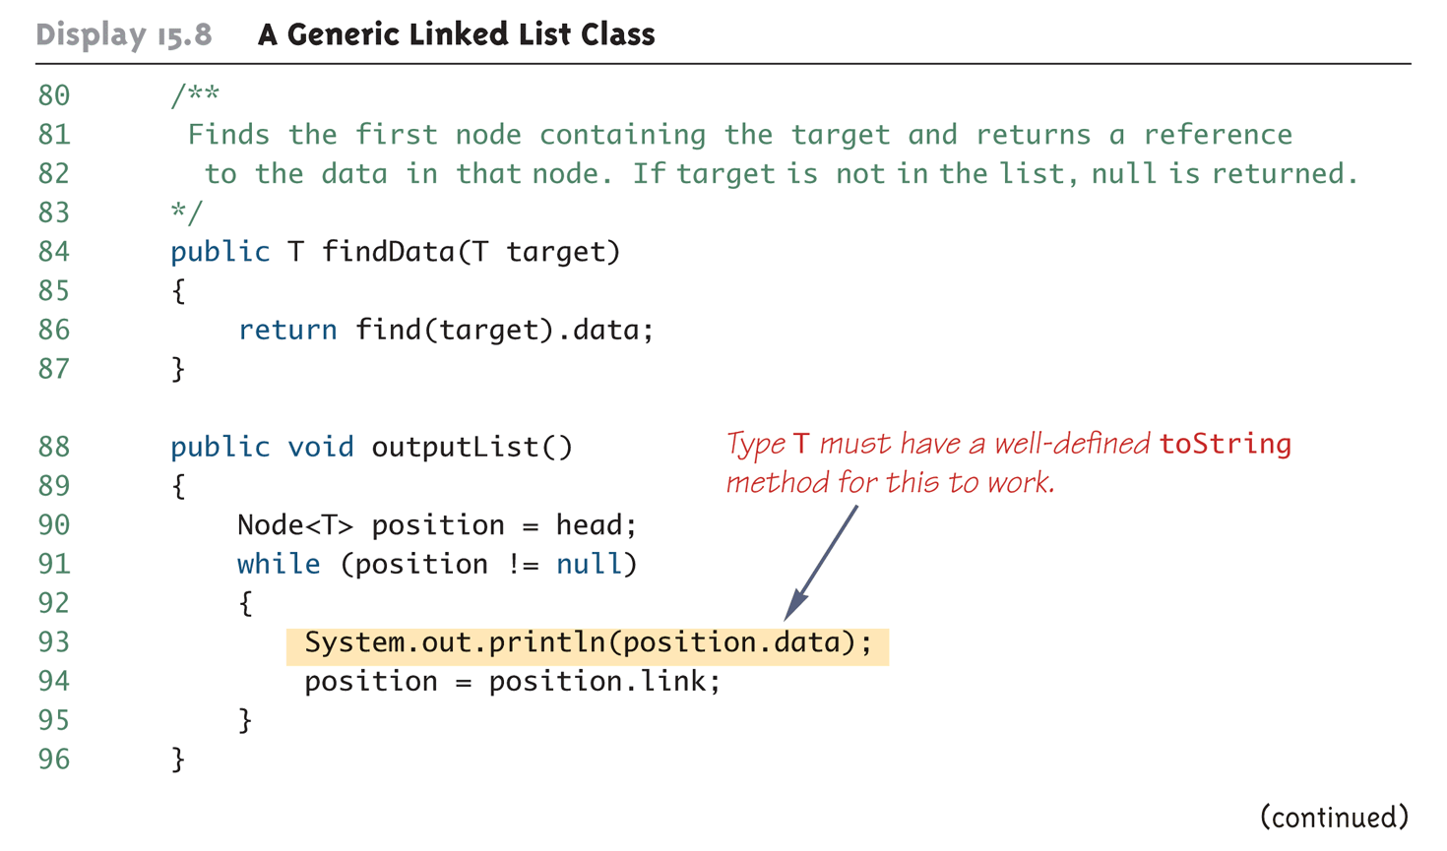
A Generic Linked List Class (Part 6 of 9)

Slide 42
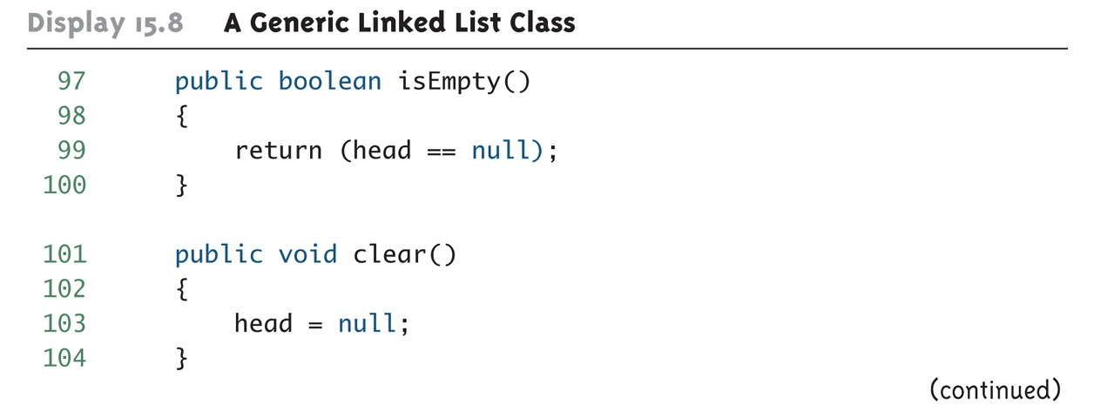
A Generic Linked List Class (Part 7 of 9)

Slide 43
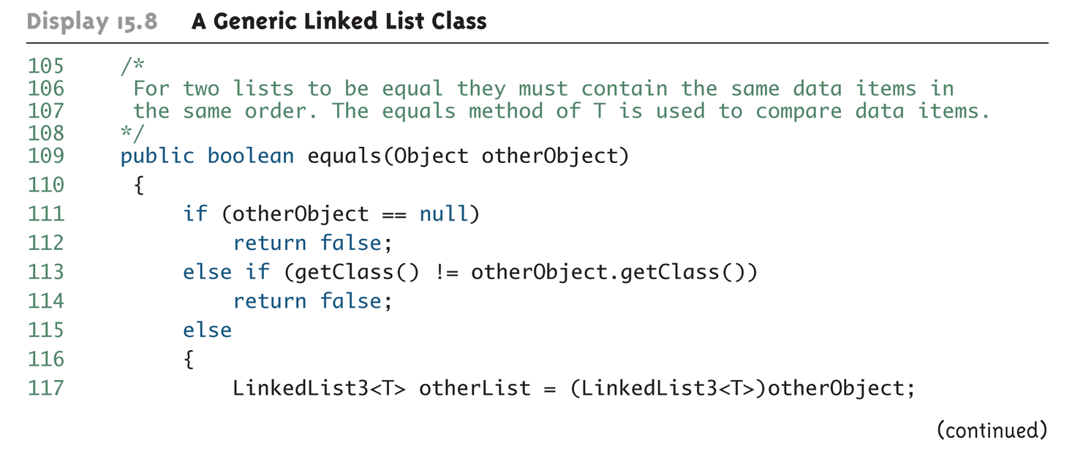
A Generic Linked List Class (Part 8 of 9)

Slide 44
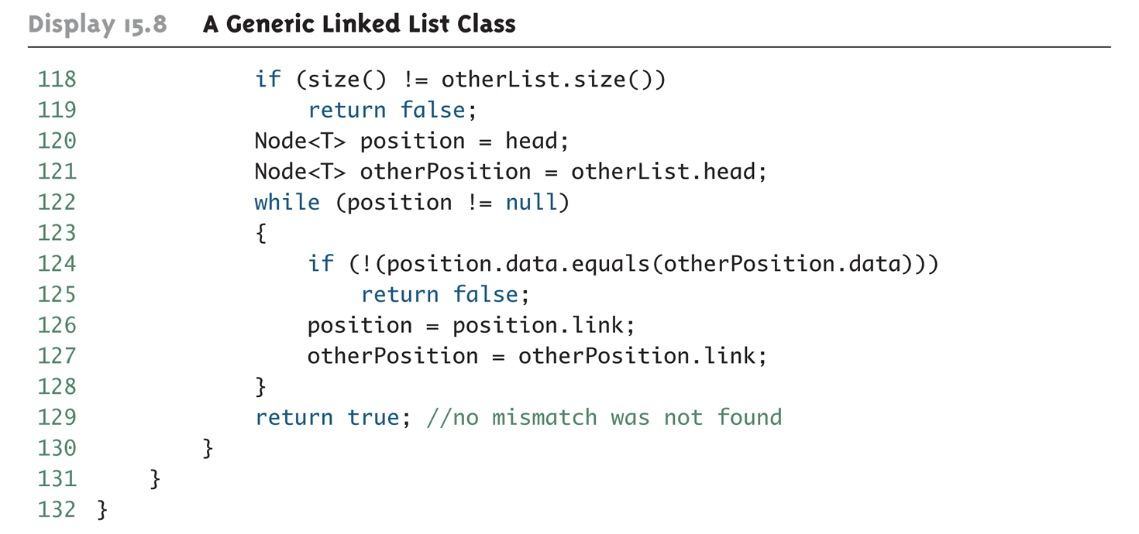
A Generic Linked List Class (Part 9 of 9)

Slide 45
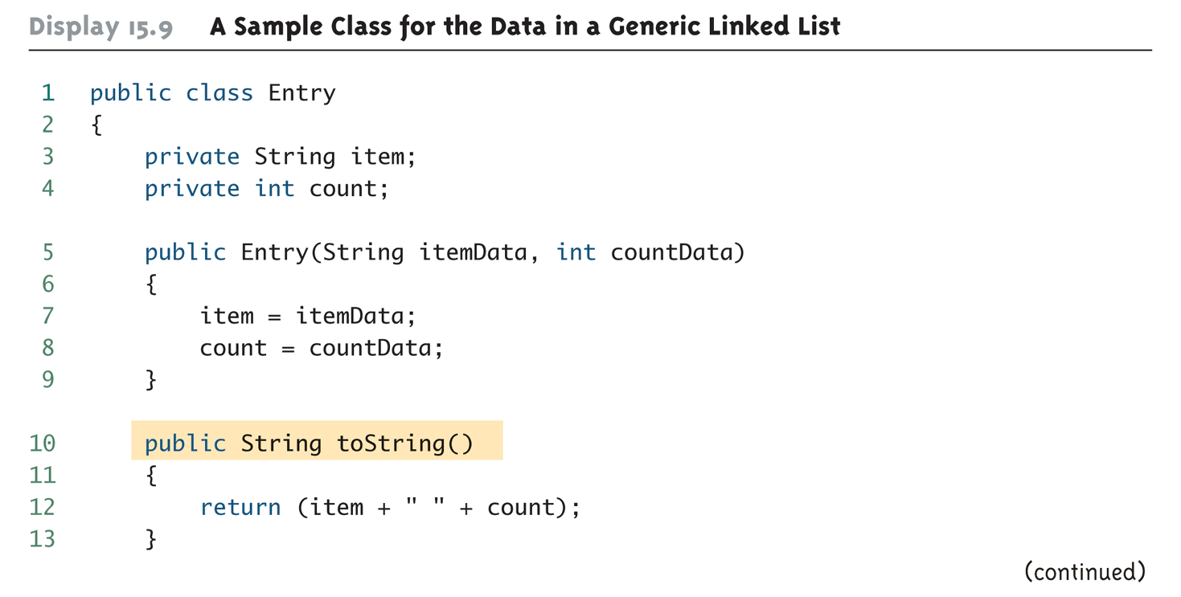
A Sample Class for the Data in a Generic Linked List (Part 1 of 2)

Slide 46
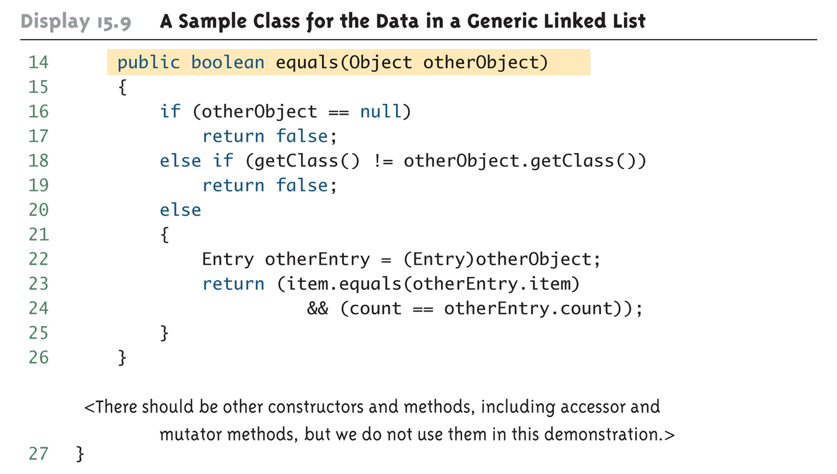
A Sample Class for the Data in a Generic Linked List (Part 2 of 2)

Slide 47
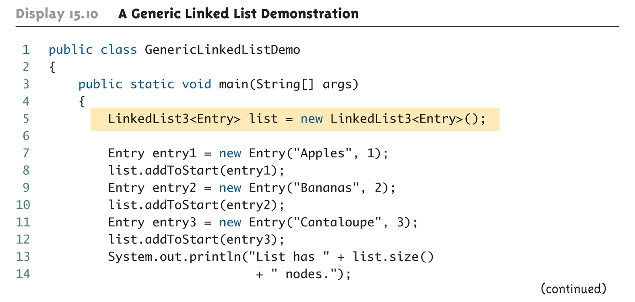
A Generic Linked List Demonstration (Part 1 of 2)

Slide 48
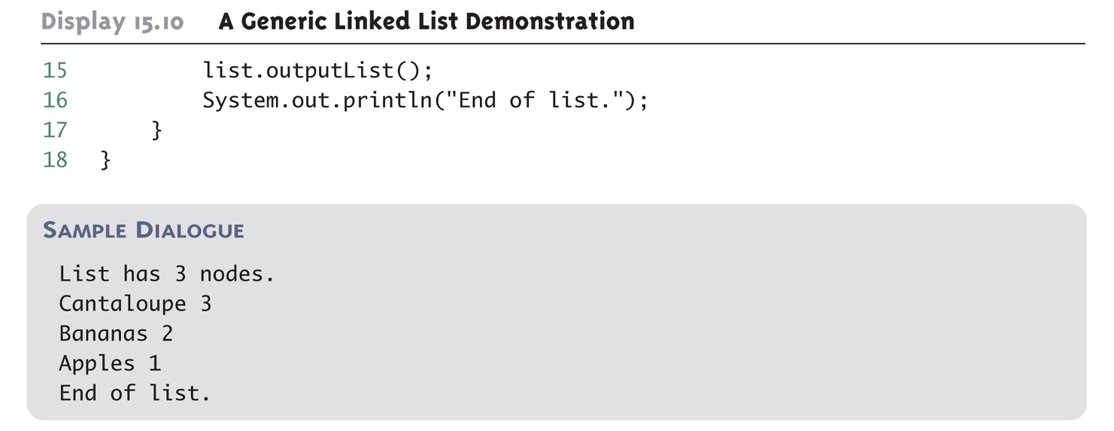
A Generic Linked List Demonstration (Part 2 of 2)

Slide 49
Pitfall: Using Node instead of Node<T>
Note: This pitfall is explained by example – any names can be substituted for the node Node and its parameter <T>
When defining the LinkedList3<T> class, the type for a node is Node<T>, not Node
If the <T> is omitted, this is an error for which the compiler may or may not issue an error message (depending on the details of the code), and even if it does, the error message may be quite strange
Look for a missing <T> when a program that uses nodes with type parameters gets a strange error message or doesn't run correctly

Slide 50
A Generic Linked List: the equals Method
Like other classes, a linked list class should normally have an equals method
The equals method can be defined in a number of reasonable ways
Different definitions may be appropriate for different situations
Two such possibilities are the following:
They contain the same data entries (possibly in different orders)
They contain the same data entries in the same order
Of course, the type plugged in for T must also have redefined the equals method

Slide 51
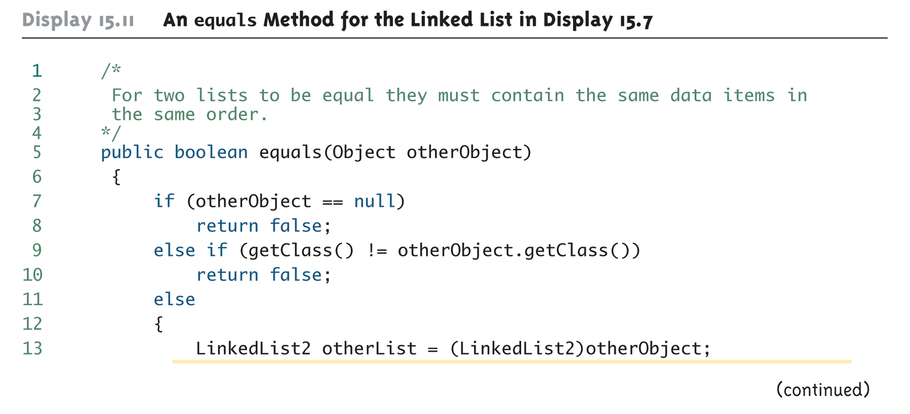
An equals Method for the Linked List in Display 15.7 (Part 1 of 2)

Slide 52
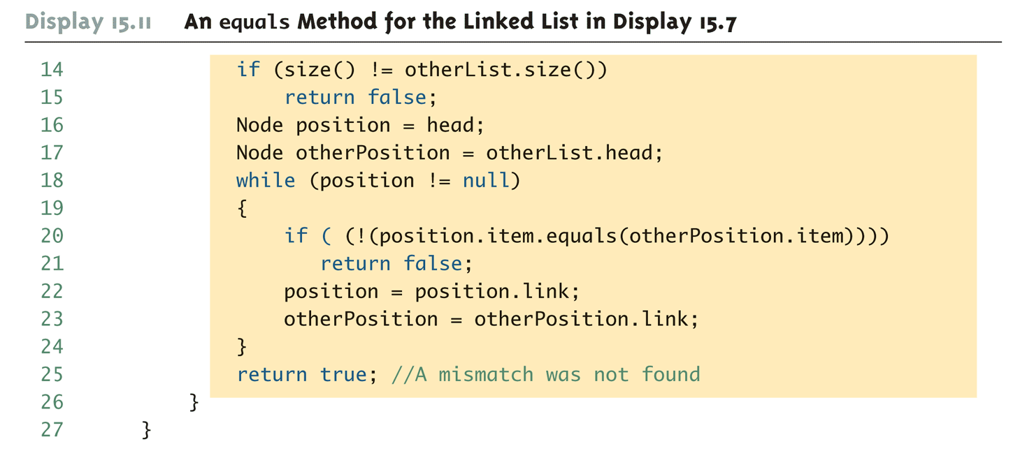
An equals Method for the Linked List in Display 15.7 (Part 2 of 2)

Slide 53
Simple Copy Constructors and clone Methods
There is a simple way to define copy constructors and the clone method for data structures such as linked lists
Unfortunately, this approach produces only shallow copies
The private helping method copyOf is used by both the copy constructor and the clone method
The copy constructor uses copyOf to create a copy of the list of nodes
The clone method first invokes its superclass clone method, and then uses copyOf to create a clone of the list of nodes

Slide 54
A Generic Linked List: the private method copyOf
The private helping method copyOf takes an argument that is a reference to a head node of a linked list, and returns a reference to the head node of a copy of that list
It goes down the argument list one node at a time and makes a copy of each node
The new nodes are added to the end of the linked list being built
However, although this produces a new linked list with all new nodes, the new list is not truly independent because the data object is not cloned

Slide 55
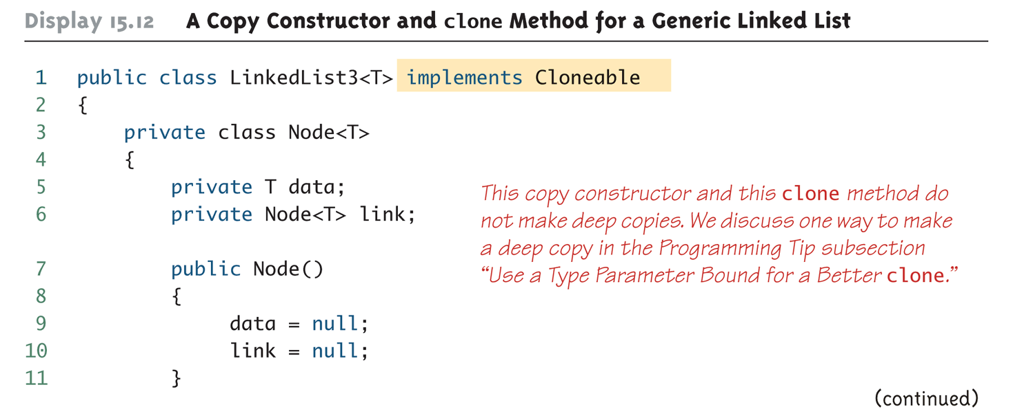
A Copy Constructor and clone Method for a Generic Linked List (Part 1 of 6)

Slide 56
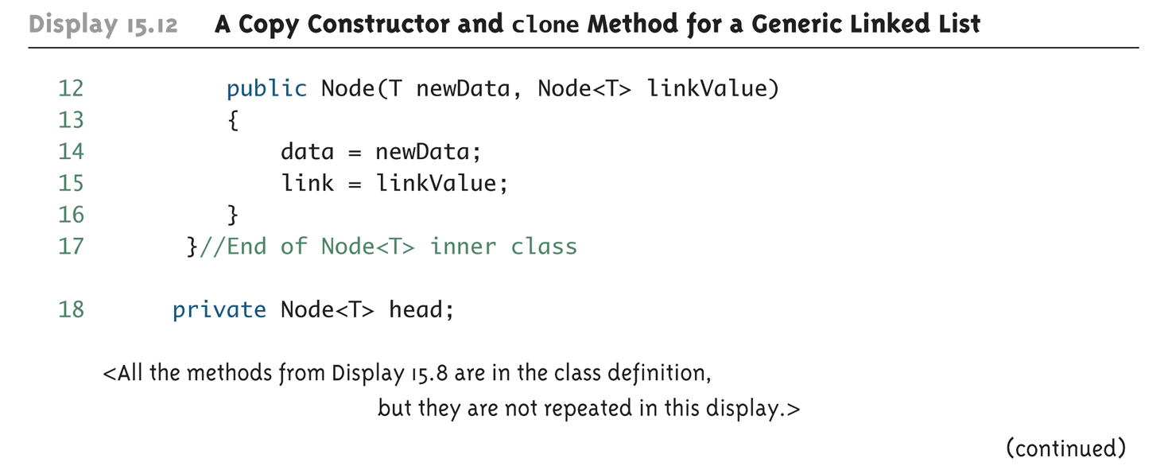
A Copy Constructor and clone Method for a Generic Linked List (Part 2 of 6)

Slide 57
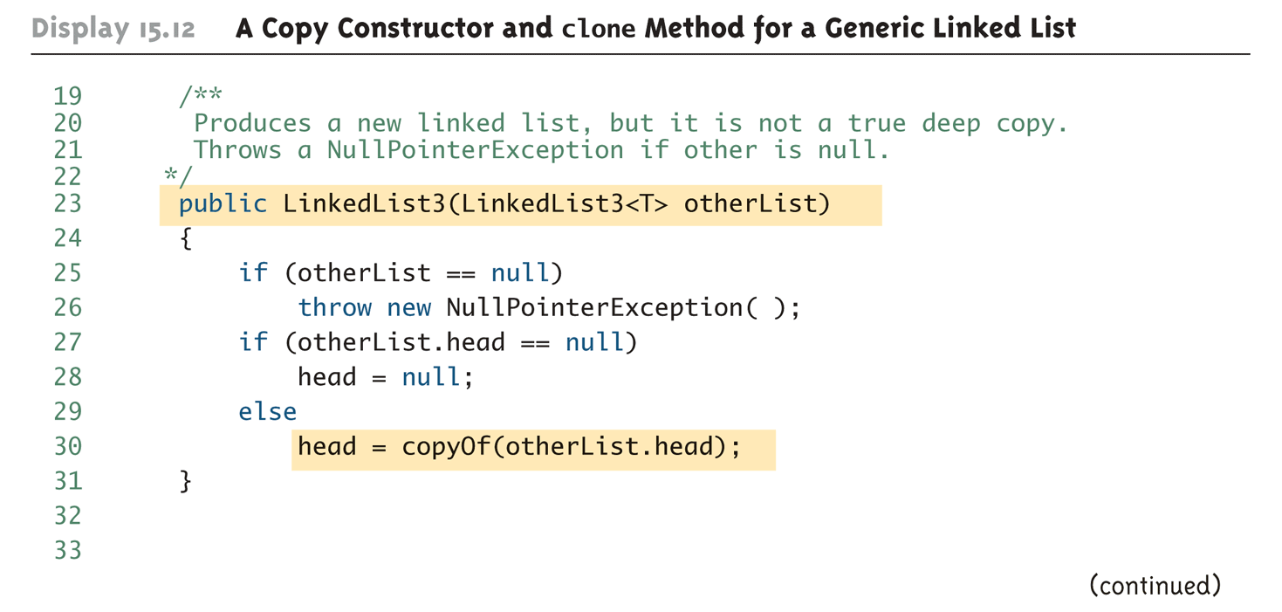
A Copy Constructor and clone Method for a Generic Linked List (Part 3 of 6)

Slide 58
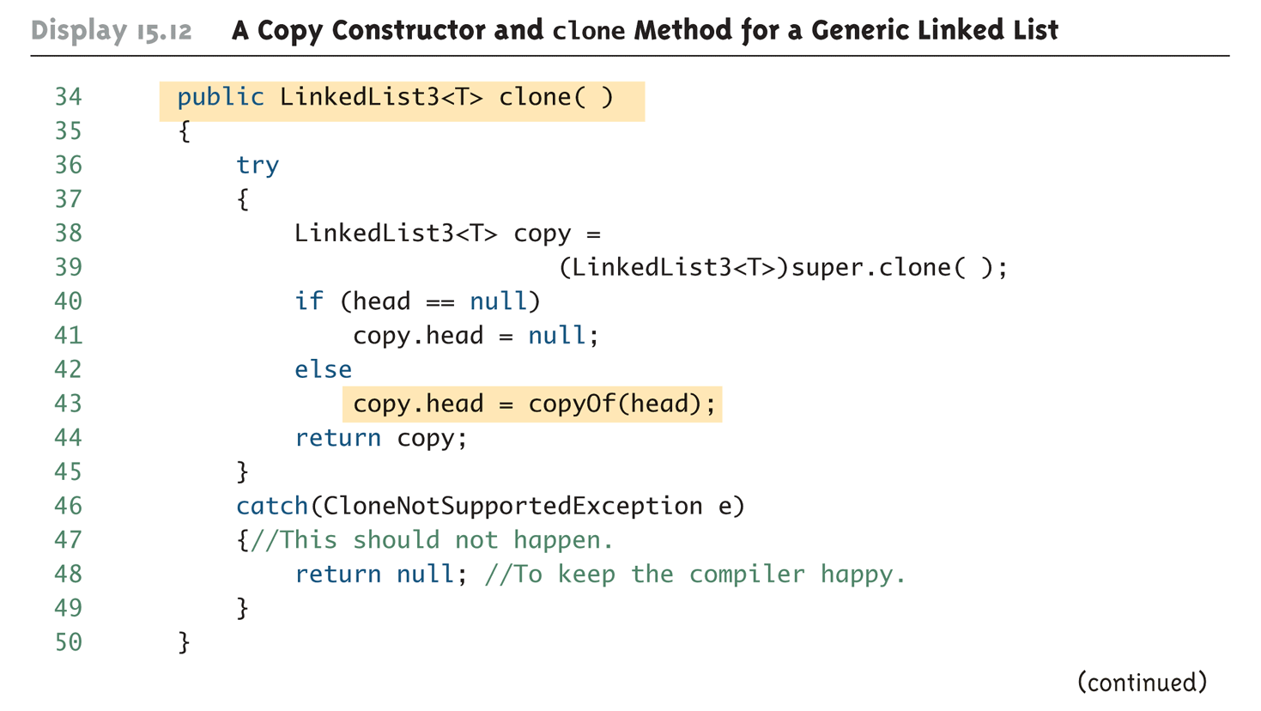
A Copy Constructor and clone Method for a Generic Linked List (Part 4 of 6)

Slide 59
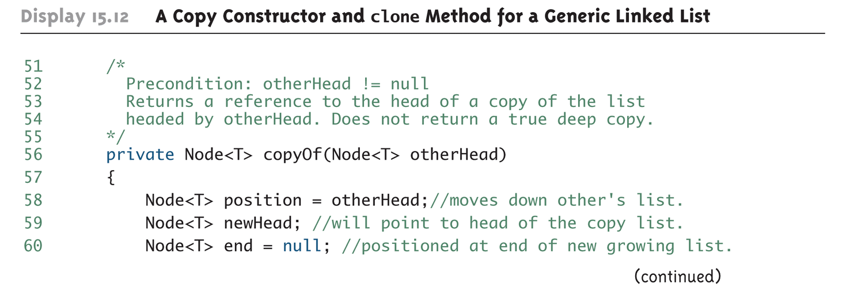
A Copy Constructor and clone Method for a Generic Linked List (Part 5 of 6)

Slide 60
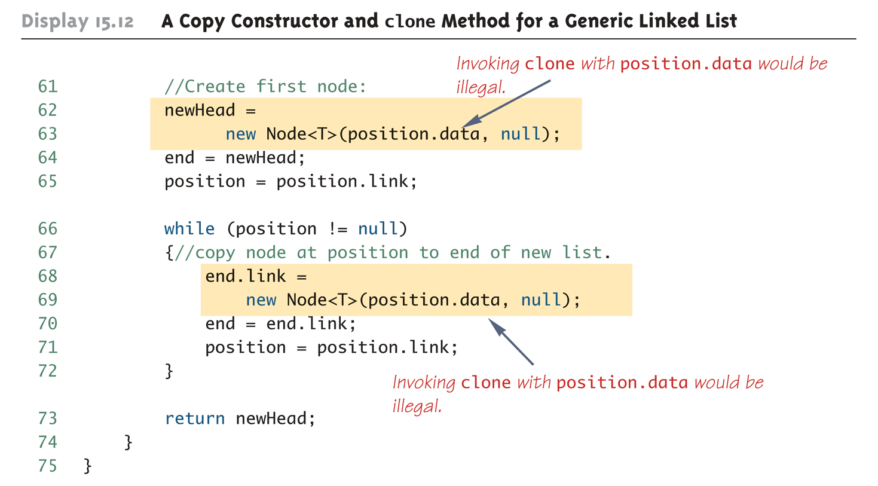
A Copy Constructor and clone Method for a Generic Linked List (Part 6 of 6)

Slide 61
Pitfall: The clone Method Is Protected in Object
It would have been preferable to clone the data belonging to the list being copied in the copyOf method as follows:
nodeReference = new
Node((T)(position.data).clone(), null);
However, this is not allowed, and this code will not compile
The error message generated will state that clone is protected in Object
Although the type used is T, not Object, any class can be plugged in for T
When the class is compiled, all that Java knows is that T is a descendent class of Object

Slide 62
Exceptions
A generic data structure is likely to have methods that throw exceptions
Situations such as a null argument to the copy constructor may be handled differently in different situations
If this happens, it is best to throw a NullPointerException, and let the programmer who is using the linked list handle the exception, rather than take some arbitrary action
A NullPointerException is an unchecked exception: it need not be caught or declared in a throws clause

Slide 63
Tip: Use a Type Parameter Bound for a Better clone
One solution to this problem is to place a bound on the type parameter T so that it must satisfy a suitable interface
Although there is no standard interface that does this, it is easy to define one
For example, a PubliclyCloneable interface could be defined

Slide 64
Tip: Use a Type Parameter Bound for a Better clone
Any class that implements the PubliclyCloneable interface would have these three properties:
It would implement the Cloneable interface because PubliclyCloneable extends Cloneable
It would have to implement a public clone method
Its clone method would have to make a deep copy

Slide 65
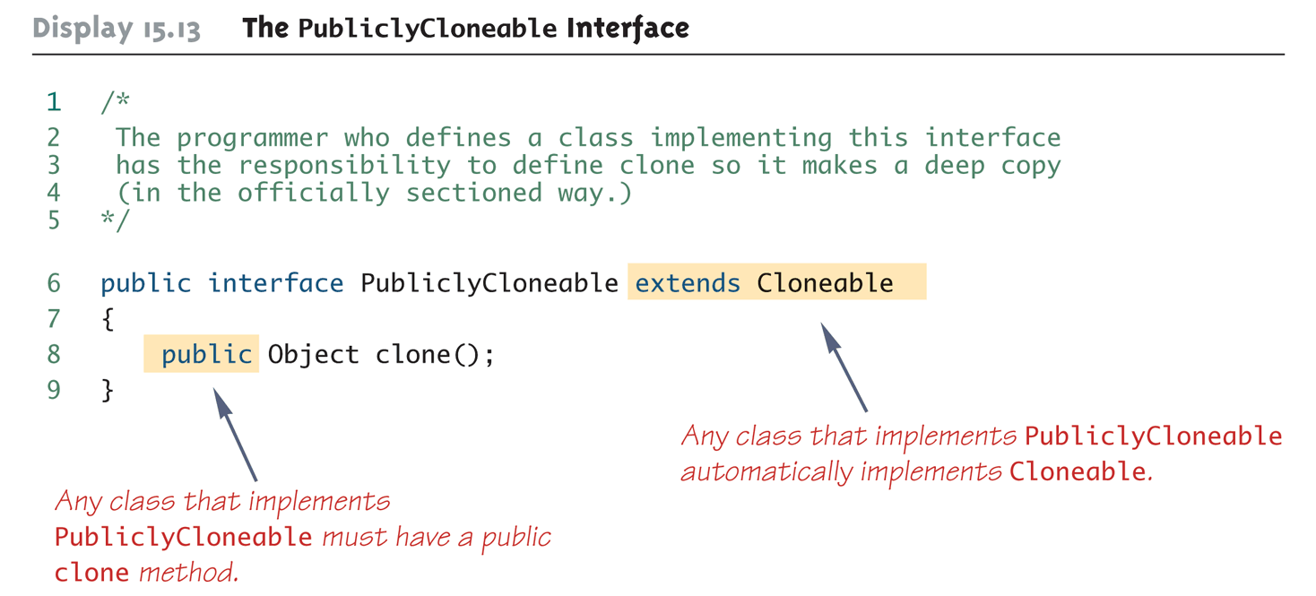
The PubliclyCloneable Interface

Slide 66
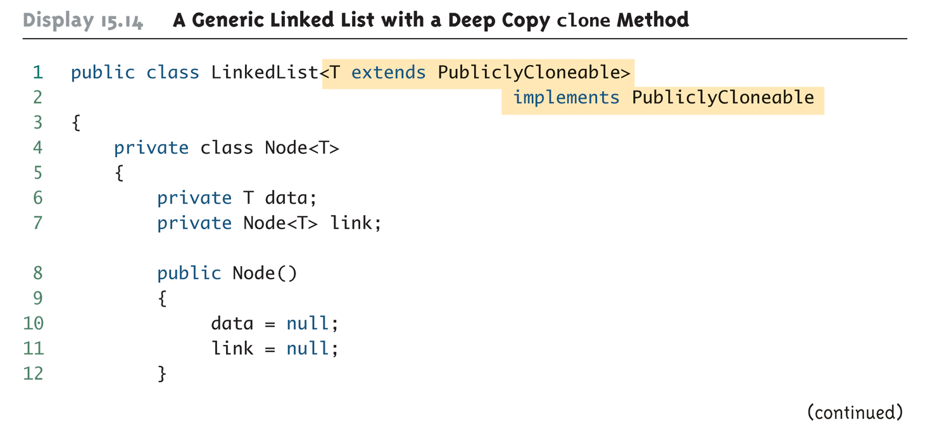
A Generic Linked List with a Deep Copy clone Method (Part 1 of 8)

Slide 67
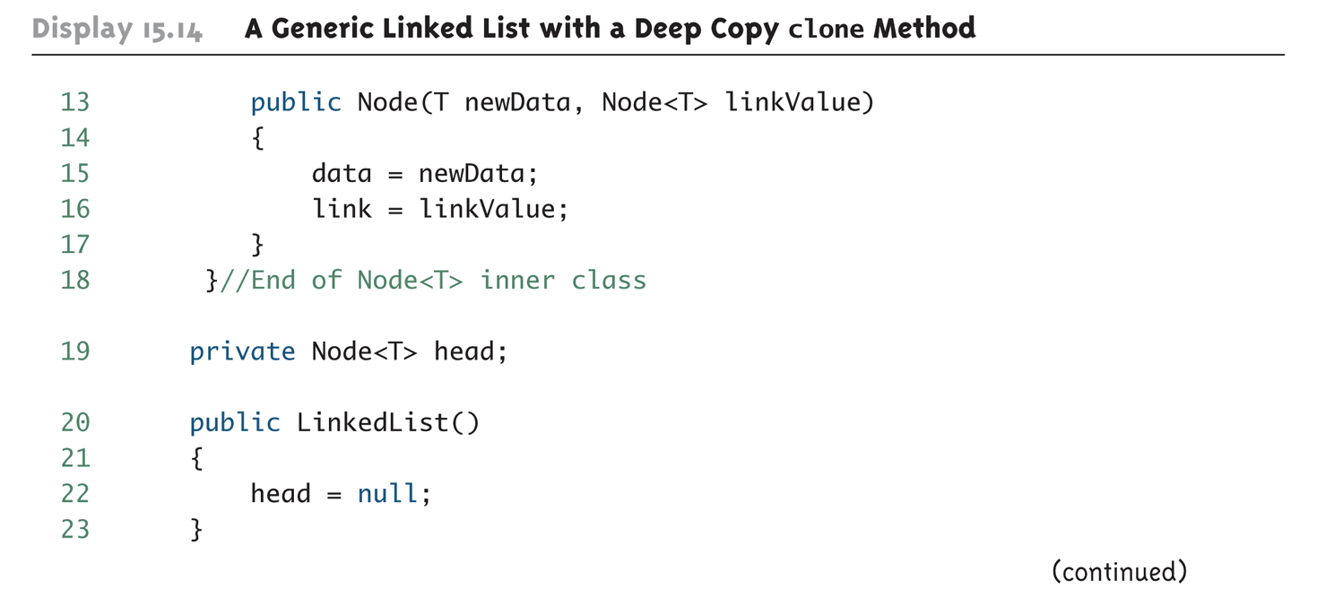
A Generic Linked List with a Deep Copy clone Method (Part 2 of 8)

Slide 68
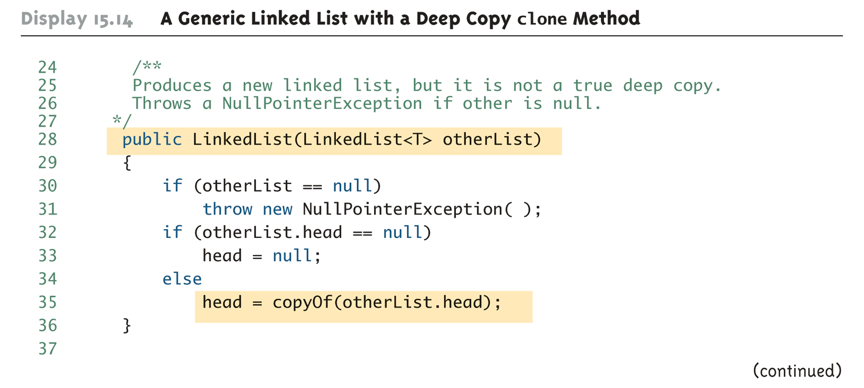
A Generic Linked List with a Deep Copy clone Method (Part 3 of 8)

Slide 69
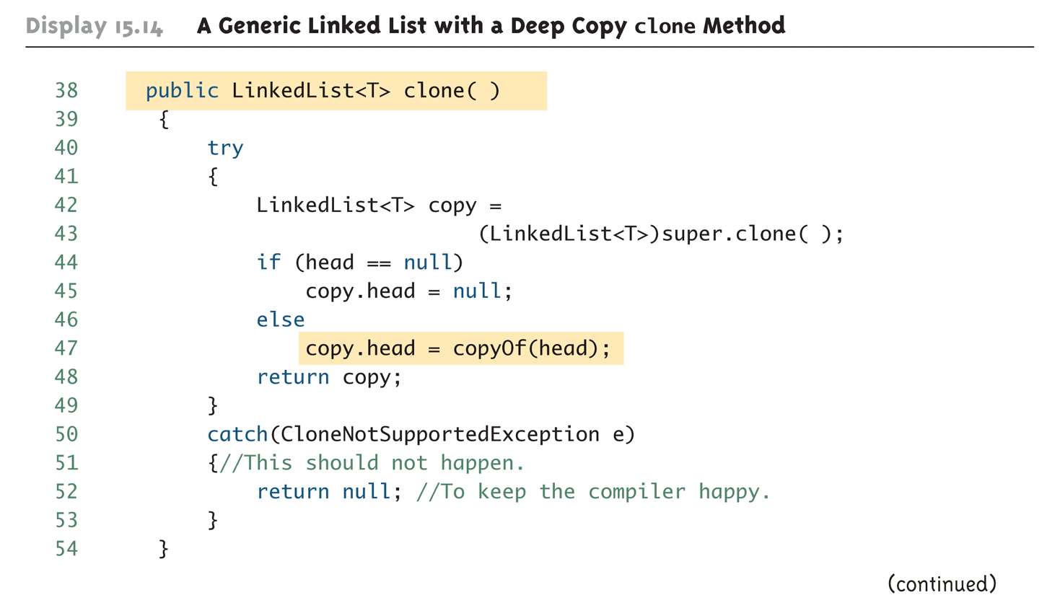
A Generic Linked List with a Deep Copy clone Method (Part 4 of 8)

Slide 70
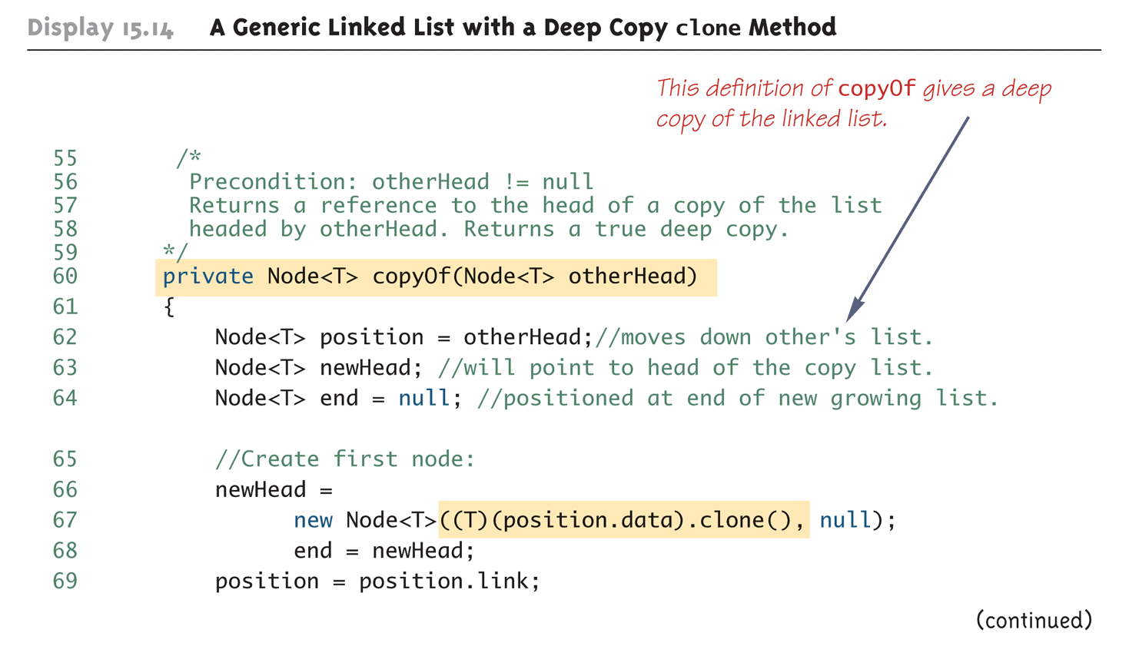
A Generic Linked List with a Deep Copy clone Method (Part 5 of 8)

Slide 71
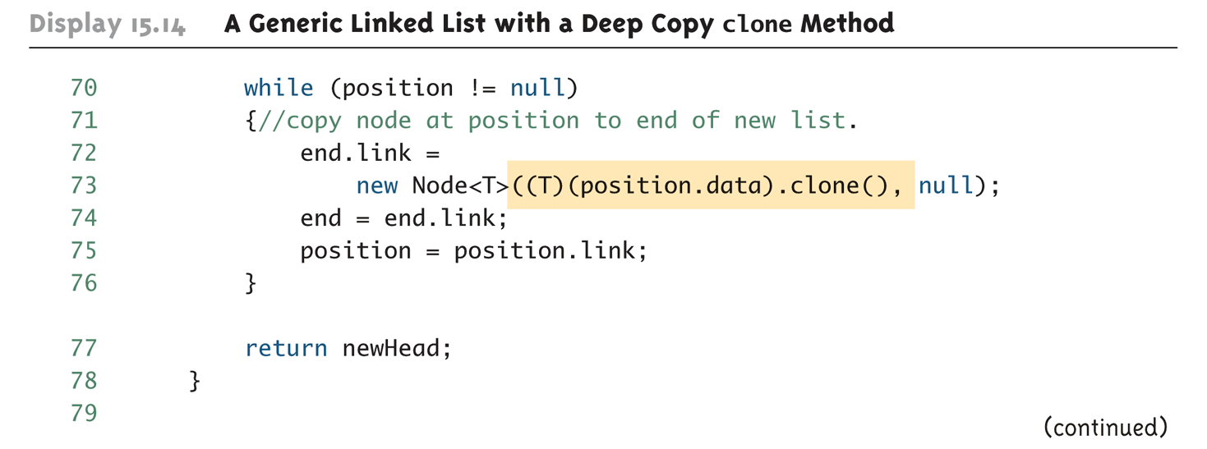
A Generic Linked List with a Deep Copy clone Method (Part 6 of 8)

Slide 72
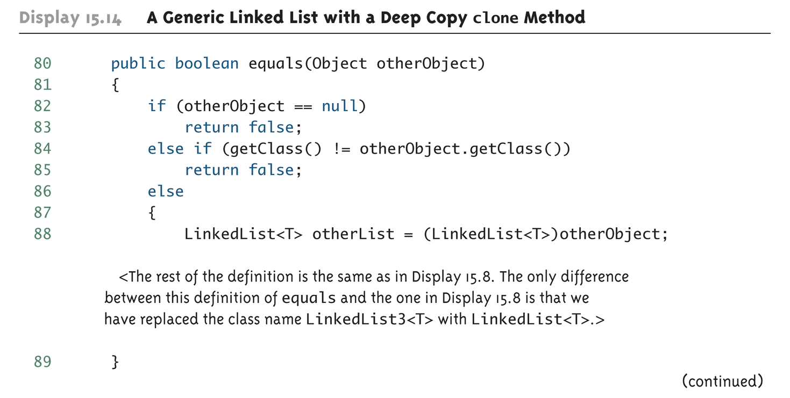
A Generic Linked List with a Deep Copy clone Method (Part 7 of 8)

Slide 73
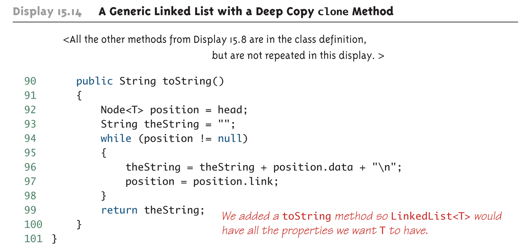
A Generic Linked List with a Deep Copy clone Method (Part 8 of 8)

Slide 74
A Linked List with a Deep Copy clone Method
Some of the details of the clone method in the previous linked list class may be puzzling, since the following code would also return a deep copy:
public LinkedList<T> clone()
{
return new LInkedList<T>(this);
}
However, because the class implements PubliclyCloneable which, in turn, extends Cloneable, it must implement the Cloneable interface as specified in the Java documentation

Slide 75

A PubliclyCloneable Class (Part 1 of 4)

Slide 76

A PubliclyCloneable Class (Part 2 of 4)

Slide 77

A PubliclyCloneable Class (Part 3 of 4)

Slide 78

A PubliclyCloneable Class (Part 4 of 4)

Slide 79

Demonstration of Deep Copy clone (Part 1 of 3)

Slide 80

Demonstration of Deep Copy clone (Part 2 of 3)

Slide 81

Demonstration of Deep Copy clone (Part 3 of 3)

Slide 82
Tip: Cloning is an "All or Nothing" Affair
If a clone method is defined for a class, then it should follow the official Java guidelines
In particular, it should implement the Cloneable interface

Slide 83
Iterators
A collection of objects, such as the nodes of a linked list, must often be traversed in order to perform some action on each object
An iterator is any object that enables a list to be traversed in this way
A linked list class may be created that has an iterator inner class
If iterator variables are to be used outside the linked list class, then the iterator class would be made public
The linked list class would have an iterator method that returns an iterator for its calling object
Given a linked list named list, this can be done as follows:
LinkedList2.List2Iterator i = list.iterator();

Slide 84
Iterators
The basic methods used by an iterator are as follows:
restart: Resets the iterator to the beginning of the list
hasNext: Determines if there is another data item on the list
next: Produces the next data item on the list

Slide 85

A Linked List with an Iterator (Part 1 of 6)

Slide 86

A Linked List with an Iterator (Part 2 of 6)

Slide 87

A Linked List with an Iterator (Part 3 of 6)

Slide 88

A Linked List with an Iterator (Part 4 of 6)

Slide 89

A Linked List with an Iterator (Part 5 of 6)

Slide 90

A Linked List with an Iterator (Part 6 of 6)

Slide 91

Using an Iterator (Part 1 of 6)

Slide 92

Using an Iterator (Part 2 of 6)

Slide 93

Using an Iterator (Part 3 of 6)

Slide 94

Using an Iterator (Part 4 of 6)

Slide 95

Using an Iterator (Part 5 of 6)

Slide 96

Using an Iterator (Part 6 of 6)

Slide 97
The Java Iterator Interface
Java has an interface named Iterator that specifies how Java would like an iterator to behave
Although the iterators examined so far do not satisfy this interface, they could be easily redefined to do so

Slide 98
Adding and Deleting Nodes
An iterator is normally used to add or delete a node in a linked list
Given iterator variables position and previous, the following two lines of code will delete the node at location position:
previous.link = position.link;
position = position.link;
Note: previous points to the node before position

Slide 99
Deleting a Node (Part 1 of 2)

Slide 100
Deleting a Node (Part 2 of 2)

Slide 101
Adding and Deleting Nodes
Note that Java has automatic garbage collection
In many other languages the programmer has to keep track of deleted nodes and explicitly return their memory for recycling
This procedure is called explicit memory management
The iterator variables position and previous can be used to add a node as well
previous will point to the node before the insertion point, and position will point to the node after the insertion point
Node temp = new Node(newData,position);
previous.link = temp;

Slide 102
Adding a Node between Two Nodes (Part 1 of 2)

Slide 103
Adding a Node between Two Nodes (Part 2 of 2)

Slide 104
Variations on a Linked List
An ordinary linked list allows movement in one direction only
However, a doubly linked list has one link that references the next node, and one that references the previous node
The node class for a doubly linked list can begin as follows:
private class TwoWayNode
{
private String item;
private TwoWayNode previous;
private TwoWayNode next;
. . .
In addition, the constructors and methods in the doubly linked list class would be modified to accommodate the extra link

Slide 105

A Doubly Linked List

Slide 106

Adding a Node to the Front of a Doubly Linked List

Slide 107
Deleting a Node from a Doubly Linked List (1 of 2)

Slide 108
Deleting a Node from a Doubly Linked List (2 of 2)

Slide 109
Inserting a Node Into a Doubly Linked List (1 of 2)

Slide 110

Inserting a Node Into a Doubly Linked List (2 of 2)

Slide 111
The Stack Data Structure
A stack data structure is not necessarily a linked data structure, but can be implemented as one
A stack is a data structure that removes items in the reverse order of which they were inserted (LIFO: Last In First Out)
A linked list that inserts and deletes only at the head of the list is a stack

Slide 112
The Queue Data Structure
A queue is a data structure that handles data in a first-in/first-out fashion (FIFO) like a line at a bank
Customers add themselves to the end of the line and are served from the front of the line
A queue can be implemented with a linked list
However, a queue needs a pointer at both the head and tail (the end) of the linked list
Nodes are removed from the front (head end), and are added to the back ( tail end)

Slide 113

A Queue Class (Part 1 of 5)

Slide 114

A Queue Class (Part 2 of 5)

Slide 115

A Queue Class (Part 3 of 5)

Slide 116

A Queue Class (Part 4 of 5)

Slide 117

A Queue Class (Part 5 of 5)

Slide 118

Demonstration of the Queue Class (Part 1 of 2)

Slide 119

Demonstration of the Queue Class (Part 2 of 2)

Slide 120
Running Times
How fast is program?
"Seconds"?
Consider: large input? .. small input?
Produce "table"
Based on input size
Table called "function" in math
With arguments and return values!
Argument is input size: T(10), T(10,000), …
Function T is called "running time"

Slide 121

Table for Running Time Function: Display 15.31 Some Values of a Running Time Function

Slide 122
Consider Sorting Program
Faster on smaller input set?
Perhaps
Might depend on "state" of set
"Mostly" sorted already?
Consider worst-case running time
T(N) is time taken by "hardest" list
List that takes longest to sort

Slide 123
Counting Operations
T(N) given by formula, such as: T(N) = 5N + 5
"On inputs of size N program runs for 5N + 5 time units"
Must be "computer-independent"
Doesn’t matter how "fast" computers are
Can’t count "time"
Instead count "operations"

Slide 124
Counting Operations Example
int i = 0; Boolean found = false; while (( i < N) && !found) if (a[I] == target) found = true; else i++;
5 operations per loop iteration: <, &&, !, [ ], ==, ++
After N iterations, final three: <, &&, !
So: 6N+5 operations when target not found

Slide 125
Big-O Notation
Recall: 6N+5 operations in "worst-case"
Expressed in "Big-O" notation
Some constant "c" factor where c(6N+5) is actual running time
c different on different systems
We say code runs in time O(6N+5)
But typically only consider "highest term"
Term with highest exponent
O(N) here

Slide 126
Big-O Terminology
Linear running time:
O(N)—directly proportional to input size N
Quadratic running time:
O(N²)
Logarithmic running time:
O(log N)
Typically "log base 2"
Very fast algorithms!

Slide 127

Display 15.32 Comparison of Running Times

Slide 128
Efficiency of Linked Lists
Find method for linked list
May have to search entire list
On average would expect to search half of the list, or n/2
In big-O notation, this is O(n)
Adding to a linked list
When adding to the start we only reassign some references
Constant time or O(1)

Slide 129
Hash Tables
A hash table or hash map is a data structure that efficiently stores and retrieves data from memory
Here we discuss a hash table that uses an array in combination with singly linked lists
Uses a hash function
Maps an object to a key
In our example, a string to an integer

Slide 130
Simple Hash Function for Strings
Sum the ASCII value of every character in the string and then compute the modulus of the sum using the size of the fixed array.
private int computeHash(String s)
{
int hash = 0;
for (int i = 0; i < s.length(); i++)
{
hash += s.charAt(i);
}
return hash % SIZE; // SIZE = 10 in example
}
Example: “dog” = ASCII 100, 111, 103
Hash = (100 + 111 + 103) % 10 = 4

Slide 131
Hash Table Idea
Storage
Make an array of fixed size, say 10
In each array element store a linked list
To add an item, map (i.e. hash) it to one of the 10 array elements, then add it to the linked list at that location
Retrieval
To look up an item, determine its hash code then search the linked list at the corresponding array slot for the item

Slide 132
Constructing a Hash Table (1 of 2)

Slide 133
Constructing a Hash Table (2 of 2)

Slide 134
A Hash Table Class (1 of 3)
1 public class HashTable
2 {
3 // Uses the generic LinkedList2 class from Display 15.7
4 private LinkedList2[] hashArray;
5 private static final int SIZE = 10;
6 public HashTable()
7 {
8 hashArray = new LinkedList2[SIZE];
9 for (int i=0; i < SIZE; i++)
10 hashArray[i] = new LinkedList2();
11 }
12 private int computeHash(String s)
13 {
14 int hash = 0;
15 for (int i = 0; i < s.length(); i++)
16 {
17 hash += s.charAt(i);
18 }
19 return hash % SIZE;
20 }

Slide 135
A Hash Table Class (2 of 3)
21 /**
22 Returns true if the target is in the hash table,
23 false if it is not.
24 */
25 public boolean containsString(String target)
26 {
27 int hash = computeHash(target);
28 LinkedList2 list = hashArray[hash];
29 if (list.contains(target))
30 return true;
31 return false;
32 }

Slide 136
A Hash Table Class (3 of 3)
33 /**
34 Stores or puts string s into the hash table
35 */
36 public void put(String s)
37 {
38 int hash = computeHash(s); // Get hash value
39 LinkedList2 list = hashArray[hash];
40 if (!list.contains(s))
41 {
42 // Only add the target if it's not already
43 // on the list.
44 hashArray[hash].addToStart(s);
45 }
46 }
47 } // End HashTable class

Slide 137
Hash Table Demonstration (1 of 2)
1 public class HashTableDemo
2 {
3 public static void main(String[] args)
4 {
5 HashTable h = new HashTable();
6 System.out.println("Adding dog, cat, turtle, bird");
7 h.put("dog");
8 h.put("cat");
9 h.put("turtle");
10 h.put("bird");
11 System.out.println("Contains dog? " +
12 h.containsString("dog"));
13 System.out.println("Contains cat? " +
14 h.containsString("cat"));
15 System.out.println("Contains turtle? " +
16 h.containsString("turtle"));
17 System.out.println("Contains bird? " +
18 h.containsString("bird"));

Slide 138
Hash Table Demonstration (2 of 2)
19 System.out.println("Contains fish? " +
20 h.containsString("fish"));
21 System.out.println("Contains cow? " +
22 h.containsString("cow"));
23 }
}
SAMPLE DIALOGUE
Adding dog, cat, turtle, bird
Contains dog? true
Contains cat? true
Contains turtle? true
Contains bird? true
Contains fish? false
Contains cow? false

Slide 139
Hash Table Efficiency
Worst Case
Every item inserted into the table has the same hash key, the find operation may have to search through all items every time (same performance as a linked list, O(n) to find)
Best Case
Every item inserted into the table has a different hash key, the find operation will only have to search a list of size 1, very fast, O(1) to find.
Can decrease the chance of collisions with a better hash function
Tradeoff: Lower chance of collision with bigger hash table, but more wasted memory space

Slide 140
Set Template Class
A set is a collection of elements in which no element occurs more than once
We can implement a simple set that uses a linked list to store the items in the set
Fundamental set operations we will support:
Add
Contains
Union
Intersection

Slide 141
Sets Using Linked Lists

Slide 142
A Set Class (1 of 5)
1 // Uses a linked list as the internal data structure
2 // to store items in a set.
3 public class Set<T>
4 {
5 private class Node<T>
6 {
7 private T data;
8 private Node<T> link;
9 public Node( )
10 {
11 data = null;
12 link = null;
13 }
14 public Node(T newData, Node<T> linkValue)
15 {
16 data = newData;
17 link = linkValue;
18 }
19 }//End of Node<T> inner class
20 private Node<T> head;

Slide 143
A Set Class (2 of 5)
21 public Set()
22 {
23 head = null;
24 }
25 /**
26 Add a new item to the set. If the item
27 is already in the set, false is returned,
28 otherwise true is returned.
29 */
30 public boolean add(T newItem)
31 {
32 if (!contains(newItem))
33 {
34 head = new Node<T>(newItem, head);
35 return true;
36 }
37 return false;
38 }

Slide 144
A Set Class (3 of 5)
39 public boolean contains(T item)
40 {
41 Node<T> position = head;
42 T itemAtPosition;
43 while (position != null)
44 {
45 itemAtPosition = position.data;
46 if (itemAtPosition.equals(item))
47 return true;
48 position = position.link;
49 }
50 return false; //target was not found
51 }
52 public void output( )
53 {
54 Node position = head;
55 while (position != null)
56 {
57 System.out.print(position.data.toString() + " ");
58 position = position.link;
59 }
60 System.out.println();
61 }

Slide 145
A Set Class (4 of 5)
62 /**
63 Returns a new set that is the union
64 of this set and the input set.
65 */
66 public Set<T> union(Set<T> otherSet)
67 {
68 Set<T> unionSet = new Set<T>();
69 // Copy this set to unionSet
70 Node<T> position = head;
71 while (position != null)
72 {
73 unionSet.add(position.data);
74 position = position.link;
75 }
76 // Copy otherSet items to unionSet.
77 // The add method eliminates any duplicates.
78 position = otherSet.head;
79 while (position != null)
80 {
81 unionSet.add(position.data);
82 position = position.link;
83 }
84 return unionSet;
85 }

Slide 146
A Set Class (5 of 5)
86 /**
87 Returns a new that is the intersection
88 of this set and the input set.
89 */
90 public Set<T> intersection(Set<T> otherSet)
91 {
92 Set<T> interSet = new Set<T>();
93 // Copy only items in both sets
94 Node<T> position = head;
95 while (position != null)
96 {
97 if (otherSet.contains(position.data))
98 interSet.add(position.data);
99 position = position.link;
100 }
101 return interSet;
102 }
103 }
The clear, size, and isEmpty methods are identicalto those in Display 15.8
for the LinkedList3 class.

Slide 147
A Set Class Demo (1 of 3)
1 class SetDemo
2 {
3 public static void main(String[] args)
4 {
5 // Round things
6 Set round = new Set<String>();
7 // Green things
8 Set green = new Set<String>();
9 // Add some data to both sets
10 round.add("peas");
11 round.add("ball");
12 round.add("pie");
13 round.add("grapes");
14 green.add("peas");
15 green.add("grapes");
16 green.add("garden hose");
17 green.add("grass");
18 System.out.println("Contents of set round: ");
19 round.output();
20 System.out.println("Contents of set green: ");
21 green.output();
22 System.out.println();

Slide 148
A Set Class Demo (2 of 3)
23 System.out.println("ball in set round? " +
24 round.contains("ball"));
25 System.out.println("ball in set green? " +
26 green.contains("ball"));
27 System.out.println("ball and peas in same set? " +
28 ((round.contains("ball") &&
29 (round.contains("peas"))) ||
30 (green.contains("ball") &&
31 (green.contains("peas")))));
32 System.out.println("pie and grass in same set? " +
33 ((round.contains("pie") &&
34 (round.contains("grass"))) ||
35 (green.contains("pie") &&
36 (green.contains("grass")))));

Slide 149
A Set Class Demo (3 of 3)
37 System.out.print("Union of green and round: ");
38 round.union(green).output();
39 System.out.print("Intersection of green and round: ");
40 round.intersection(green).output();
41 }
}
SAMPLE DIALOGUE
Contents of set round:
grapes pie ball peas
Contents of set green:
Grass garden hose grapes peas
ball in set round? true
ball in set green? false
ball and peas in same set? true
pie and grass in same set? false
Union of green and round: garden hose grass peas ball pie grapes
Intersection of green and round: peas grapes

Slide 150
Trees
Trees are a very important and widely used data structure
Like linked lists, they are a structure based on nodes and links, but are more complicated than linked lists
All trees have a node called the root
Each node in a tree can be reached by following the links from the root to the node
There are no cycles in a tree: Following the links will always lead to an "end"

Slide 151
Trees
A binary tree is the most common kind of tree
Each node in a binary tree has exactly two link instance variables
A binary tree must satisfy the Binary Search Tree Storage Rule
The root of the tree serves a purpose similar to that of the instance variable head in a linked list
The node whose reference is in the root instance variable is called the root node
The nodes at the "end" of the tree are called leaf nodes
Both of the link instance variables in a leaf node are null

Slide 152

A Binary Tree (Part 1 of 2)

Slide 153

A Binary Tree (Part 2 of 2)

Slide 154
Binary Search Tree Storage Rule
All the values in the left subtree must be less than the value in the root node
All the values in the right subtree must be greater than or equal to the value in the root node
This rule is applied recursively to each of the two subtrees
(The base case for the recursion is an empty tree)

Slide 155
Tree Properties
Note that a tree has a recursive structure
Each tree has two subtrees whose root nodes are the nodes pointed to by the leftLink and rightLink of the root node
This makes it possible to process trees using recursive algorithms
If the values of a tree satisfying the Binary Search Tree Storage Rule are output using Inorder Processing, then the values will be output in order from smallest to largest

Slide 156
Preorder Processing
Process the data in the root node
Process the left subtree
Process the right subtree

Slide 157
Inorder Processing
Process the left subtree
Process the data in the root node
Process the right subtree

Slide 158
Postorder Processing
Process the left subtree
Process the right subtree
Process the data in the root node

Slide 159

A Binary Search Tree for Integers (Part 1 of 6)

Slide 160

A Binary Search Tree for Integers (Part 2 of 6)

Slide 161

A Binary Search Tree for Integers (Part 3 of 6)

Slide 162

A Binary Search Tree for Integers (Part 4 of 6)

Slide 163

A Binary Search Tree for Integers (Part 5 of 6)

Slide 164

A Binary Search Tree for Integers (Part 6 of 6)

Slide 165

Demonstration Program for the Binary Search Tree (Part 1 of 3)

Slide 166

Demonstration Program for the Binary Search Tree (Part 2 of 3)

Slide 167

Demonstration Program for the Binary Search Tree (Part 3 of 3)

Slide 168
Efficiency of Binary Search Trees
A Binary search trees that is as short as possible can be processed most efficiently
A short tree is one where all paths from root to a leaf differ by at most one node
When this is so, the search method isInSubtree is about as efficient as the binary search on a sorted array
Its worst-case running time is O(log n), where n is the number of nodes in the tree

Slide 169
Efficiency of Binary Search Trees
As a tree becomes more tall and thin, this efficiency falls off
In the worst case, it is the same as that of searching a linked list with the same number of nodes
Maintaining a tree so that it remains short and fat, as nodes are added, is known as balancing the tree
A tree maintained in this manner is called a balanced tree

